Slide 1
Academic Affairs Town Hall
September 13, 2023

Slide 2
Academic Master Plan

Slide 3
Quick Update for Planning
NWCCU Accreditation
Specialized Accreditation
Planning
Assessment
Fall 2022:
Institutional accreditation and planning shifted to the Academic Programs and Assessment in the Academic Affairs Division
Creation of the Office of Institutional Effectiveness, Accreditation, and Academic Assessment (IEAAA)
Responsible for University Planning Advisory Committee (UPAC)
Defined by UVU Policy 102 as a university governance committee
Executive Steward: Wayne Vaught
Co-Chairs: Laurie Sharp & Francine Jensen
Office of IEAAA

Slide 4
University-Level Planning
UPAC Charge
Under the direction of the President, the University Planning Advisory Committee (UPAC) serves in an advisory capacity to the President and the President’s Cabinet on university-level planning matters.
Vision 2030
Academic Master Plan
Completion Plan 3.0
Digital Transformation Plan
Facilities Master Plan
Inclusion Plan
Sustainability Plan
Utah Board of Higher Education Strategic Plan

Slide 5
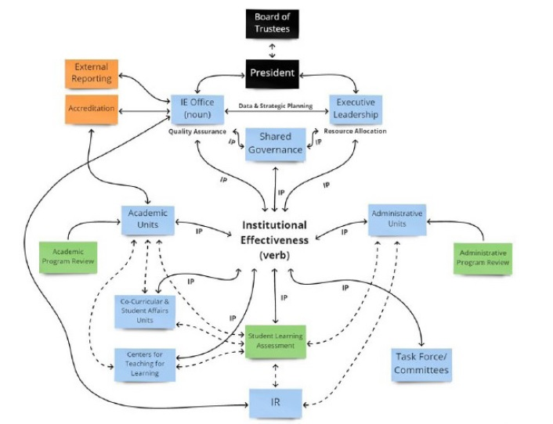
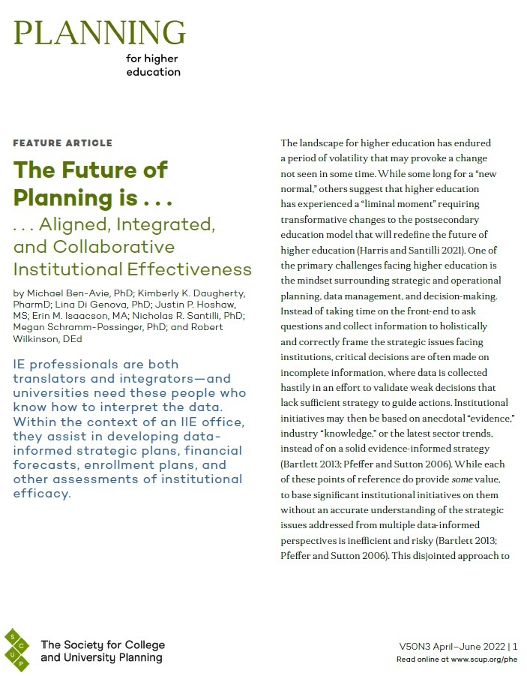
Spring 2023: Integrated Institutional Effectiveness

Slide 6
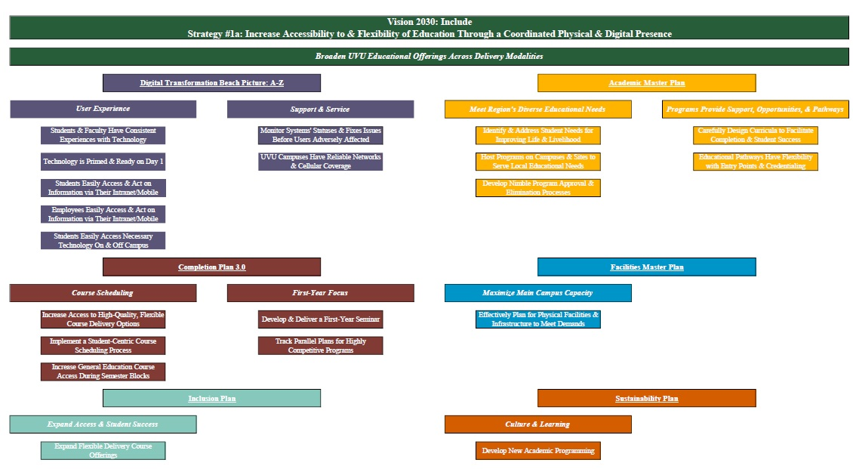
Example Developed by UPAC
2022-2023 Strategy Maps for Planning

Slide 7
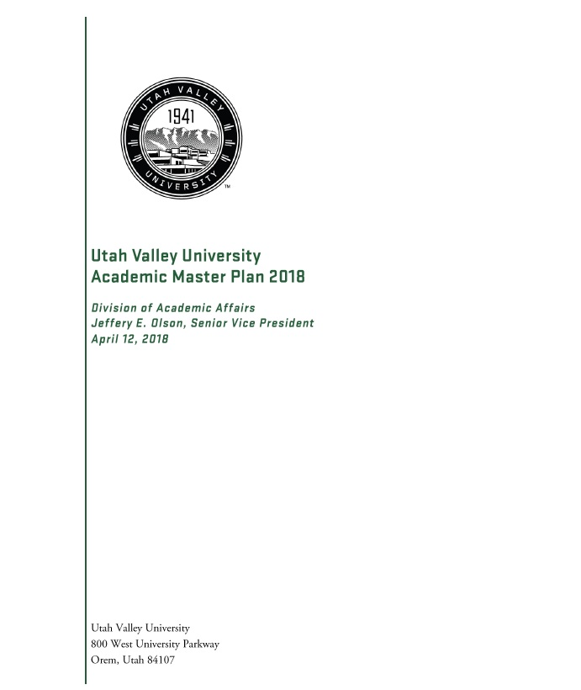
Academic Master Plan 2018: Goal Overview
Goal 1: As an open admission comprehensive community college and university, UVU meets the region's diverse educational needs.
Goal 2: Faculty, in collaboration with staff and administrators, take collective responsibility for student success.
Goal 3: General education empowers students with the foundational knowledge and skills for advanced study, the workplace, and life in the wider world.
Goal 4: Programs are designed and implemented to provide integrated support, opportunities and pathways for student success.
Goal 5: UVU engages with the community in addressing regional opportunities and challenges in a global context.
Goal 6: UVU seeks and maintains adequate resources and capacity to sustainably achieve academic goals.
Academic Master Plan 2018

Slide 8
Academic Master Plan Timeline
October 2023
Share closeout report
Present to UPAC
Form steering committee
November 2023
Seek broad stakeholder input
Gather information
December 2023
Seek broad stakeholder input
Gather information
January 2024
Draft plan
February 2024
Share draft for broad stakeholder input
March/April 2024
Revise and finalize plan
A public-facing webpage on the Academic Affairs site will be developed and contain:
Academic Master Plan 2018 closeout report
Academic Master Plan Steering Committee information (i.e., members, agendas, minutes)
Academic Master Plan timeline with progress updates
Academic Master Plan presentations and drafts
Feedback opportunities

Slide 9
Horizon Document

Slide 10
What & Why
Recognizes funding realities
Strengthens program evaluation
Employs integrated institutional effectiveness
Mitigates curriculum overlap & duplication
Creates opportunities for curricular innovation & synergy
The Horizon Document will be the university’s strategic plan for academic programming through 2030.
Partnership with Division of Academic Affairs and Division of Finance and Auxiliary Services.
Preparation efforts began in April 2023 with support from BIRS and the Budget Office.
Subsequent conversations held with academic leadership:
Provost & Dean’s Retreat – June 14
Woodbury School of Business – July 7
Smith College of Engineering & Technology – July 10
College of Science – July 20
School of the Arts – August 8
College of Humanities and Social Sciences – August 10
College of Health and Public Service – August 29
School of Education – September 7

Slide 11
Horizon Document Task
Target Completion:
April 2024
Preparation
Schools/colleges have data and information:
List of active programs
Cost per departmental full-time equivalent (DFTE) for the past 7 years
Data tables with faculty and student information for the past 7 years
List of active courses not taught for two years since Summer 2023
List of courses with credit ratio issues
Step 1
Faculty will review all data and information for their respective programs and select a desired action:
Grow (+) Increase resources to grow enrollments, retention, and completions.
Sustain (~) Sustain at current level.
Stop (-) Sunset with a teach-out plan.
Restructure (>) Complete a major restructuring (> 25% change).
Modify (<) Complete minimal curricular adjustments (< 25% change).
Step 2
Faculty will prioritize desired actions for each program and identify the appropriate academic year to begin the desired action.
Needed Time | Helpful Resources | Check Ins

Slide 12
At the Same Time . . .
Upgrading Gray Associates Software
Academic Program Evaluation (PES) Markets + PES Economics
Detailed financial scorecard for each program & course
Revenue, direct instructional costs, contribution margin, student and credit hour data
Office of IEAAA, BIRS, Budget Office, & People & Culture
Revamping Curriculum Workflow
Execute internal workflow more effectively and efficiently
Connects to Academic Master Plan & Horizon Document efforts
Strengthens proposals for courses and programs
Assures a more robust curriculum inventory

Slide 13
Questions and Answers

