Slide 1
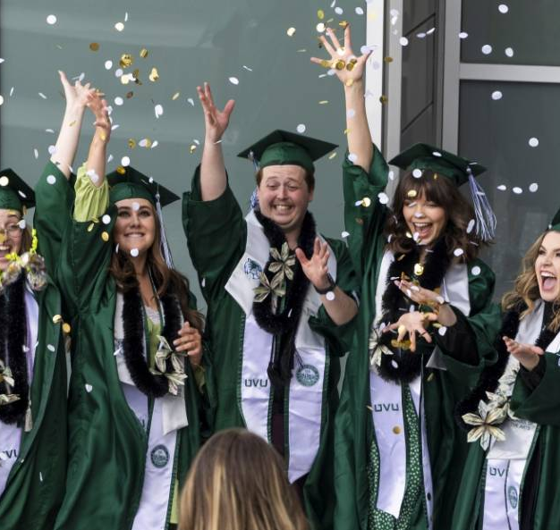

2025 Academic Master Plan Town Hall
February 12, 2025

Slide 2

Timeline
August – November 2023
Prepared & published Closeout Report for the 2018 Academic Master Plan.
January – December 2024
Academic Master Plan Steering Committee formed & drafted pillars.
Feedback elicited.
January – July 2025
Feedback elicited.
Pillars finalized.
Narrative sections & assessment plan drafted.
August 2025
2025-2030 Academic Master Plan published and implemented.

Slide 3
Executive Steward:
Wayne Vaught
Provost’s Office
Deans:
Cheryl Hanewicz & Tom Sturtevant (CHPS)
Steven Clark (CHSS) | Danny Horns (COS)
Courtney Davis (SOA) | Vessela Ilieva (SOE)
Kelly Flanagan (SCET) | Bob Allen (WSB)
Co-Chairs:
Laurie Sharp
&
Wioleta Fedeczko
School/College Faculty Representatives:
Jamie Russell (CHPS) | Pierre Lamarche (CHSS)
Merrill Halling (COS) | Jeff O’Flynn (SOA) | Bryan Waite (SOE)
Duane Andersen (SCET) | Josh Cieslewicz (WSB)
UVUSA Student Representatives:
Kenzie Womack | Ian Gotcher
Feedback Moments:
Academic Master Plan Website
Academic Affairs Town Halls
Fall 2024 School/College Meetings
Associate Deans & Department Chairs

Slide 4




Establish a clear path for the academic side of UVU
What is it we want to accomplish?
What are the measurable outcomes that we need to stay on target with?
How can we ensure that the Academic Master Plan established goals that we can achieve?
What is each individual unit doing that will help achieve our goals?

Slide 5
Academic Master Plan
Pillars
Student Success
Faculty & Staff Success
Academic Programs
Community

Slide 6
Student Success
UVU delivers transformative educational experiences that prepare students for career success, further academic pursuits, and growth.
Objective #1: Strengthen student preparation for career and academic success.
Objective #2: Improve student retention and completion.
Goal 1A: Ensure students achieve subject mastery and essential skills through targeted assessments (i.e., ELOs, PLOs, CLOs) and continuous improvement initiatives.
Goal 1B: Augment and expand high-impact educational practices, including internships, undergraduate research, service-learning, and global engagement opportunities.
Goal 2A: Increase student engagement through curricular and co-curricular programs that build a sense of community and belonging.
Goal 2B: Increase retention rates.
Goal 2C: Increase degree completion rates.

Slide 7
Faculty & Staff Success
UVU fosters a workplace culture that attracts, develops, and retains faculty and staff committed to student success.
Objective #1: Enhance faculty and staff recruitment and retention.
Objective #2: Support professional growth and innovation among faculty and staff.
Goal 1A: Strengthen faculty and staff recruitment through effective hiring processes and competitive compensation packages.
Goal 1B: Improve faculty and staff retention through professional development, recognition programs, and workplace practices that support collaboration and engagement.
Goal 2A: Expand faculty pedagogical training and certification programs to support engaging and effective instruction.
Goal 2B: Provide faculty with increased opportunities and resources for scholarly and creative work aligned with the university’s teaching mission and their areas of expertise.
Goal 2C: Strengthen professional development programs for staff to ensure they have the necessary skills and resources to excel in their roles and support student success.

Slide 8
Academic Programs
UVU offers high-quality academic programs that align with industry needs, disciplinary standards, and student interests.
Objective #2: Continuously evaluate and refine academic programs and co-curricular experiences to enhance student learning and align with workforce needs.
Objective #1: Ensure academic program relevance and rigor.
Goal 1A: Align all academic programs with established disciplinary standards, as well as any applicable professional licensure and specialized accreditation requirements.
Goal 1B: Ensure that academic programs align with workforce needs and desired skills of college graduates.
Goal 1C: Offer academic programs that integrate stackable credentials and prior learning where appropriate.
Goal 2A: Leverage data-informed insights to update and improve curricula.
Goal 2B: Strengthen collaboration with program advisory boards and regional employers to gather feedback on graduate readiness and identify areas for enhancement.

Slide 9
Community
UVU serves as a vital resource for local, regional, and global partners.
Objective #1: Cultivate and maintain partnerships that address key opportunities and challenges at local, regional, and global levels.
Objective #2: Strengthen UVU’s role as a valuable resource for communities within its service region.
Goal 1A: Establish and support partnerships that leverage university resources and faculty, staff, and student contributions to create meaningful solutions.
Goal 1B: Offer cultural, educational, and recreational experiences that enrich UVU’s service region.
Goal 2A: Communicate UVU’s cultural, educational, employment, and economic contributions to local stakeholders and state officials.
Goal 2B: Highlight successful collaborations through community events, conferences, exhibitions, forums, and media to showcase UVU’s impact and encourage new partnerships.

Slide 10
For each goal in the four pillars:
Identify existing and/or new strategies
Define measurable outcomes & success indicators
Determine required resources
Establish a timeline
Next Steps!
Your help is needed!
Executive Summary
Message from the Provost
Process & Development Overview
Student Success Pillar:
Introduction
Faculty & Staff Success Pillar:
Introduction
Academic Programs Pillar:
Introduction
Community Pillar:
Introduction

Slide 11
Thank you!
Please send questions or comments to:
Laurie Sharp: LSharp@uvu.edu
Wioleta Fedeczko: WFedeczko@uvu.edu

