Slide 1
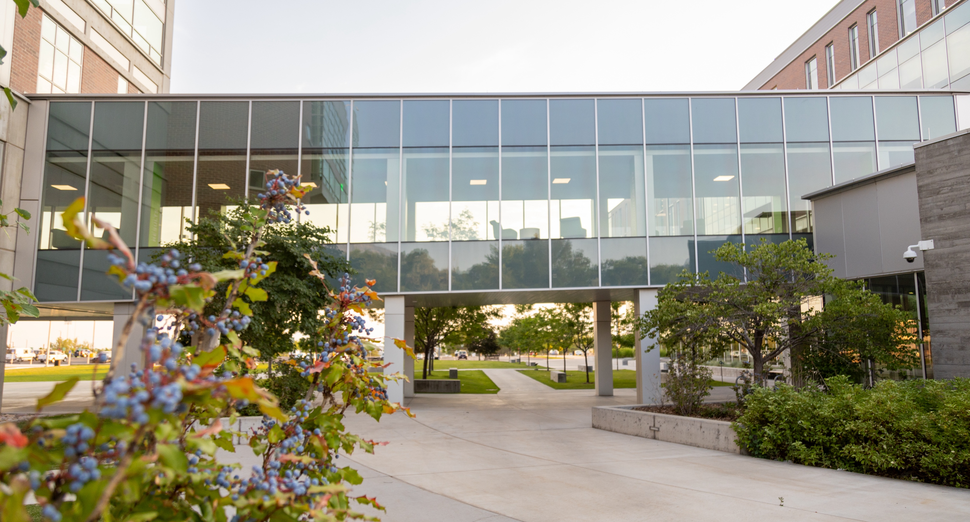

Advisory
Board
Leadership
Meeting
February 28, 2025

Slide 2




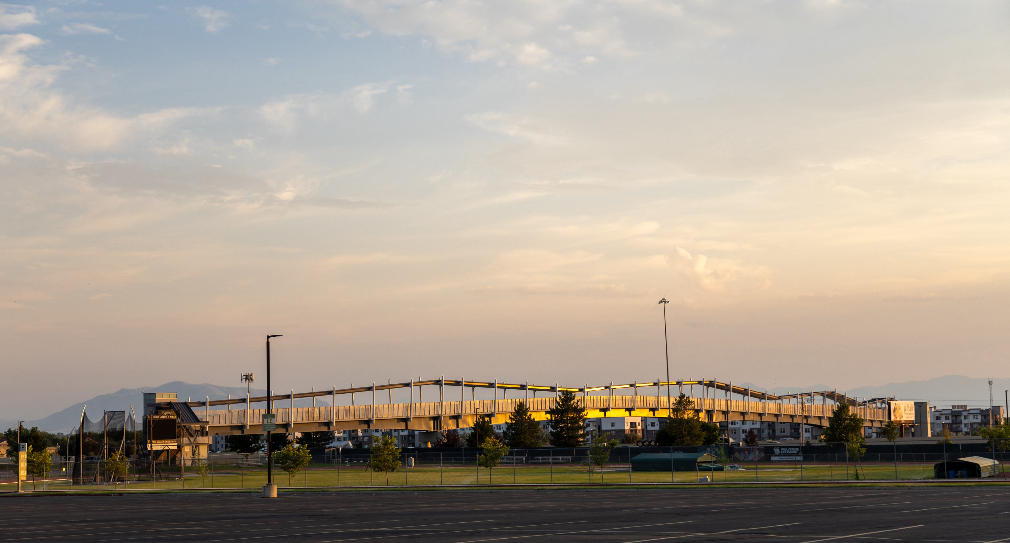

Welcome

Slide 3
LUNCH
Policy 104 Updates
Governance
Sponsorship & Charters
Reporting
STrategically Building your Board
Membership
Composition
Providing Meaningful Engagement with Students
InternEdge
Engaging Faculty with BOard Members & Industry Partners
Discussion
Involving Boards In Curriculum Reviews & Processes
Leveraging Boards to Ensure Workforce Relevance
Discussion
Planning ahead for Next Year
Agenda

Slide 4
Policy 104 Updates
Differentiate between Advancement Boards & Program Advisory Boards
Charters & Sponsoring Executive
Reinforce and clarify the requirement that all boards are chartered under a sponsoring executive
Composition
Clarify purpose of board types so that membership can be appropriately determined
Create routes for board member removal and board discontinuance through the sponsoring executive
Reporting
Clarified annual reporting requirements through the President's Office

Slide 5
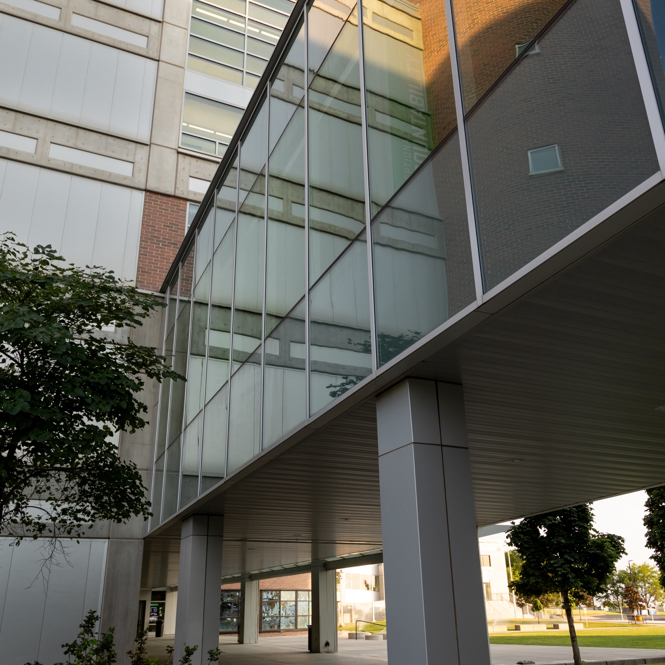
Strategically building your advisory board

Slide 6
Considerations
Purpose
Stakeholders
Which groups should be represented on the board? External? Internal?
Other Engagement
What will the board accomplish? What role do they serve?
What other mechanisms will you put in place to foster board engagement with faculty, students, administrators, advancement, donors, etc?
Size
Representation
What is the appropriate size? Do you need tiebreakers? Majority?
What breakdown (percentage) of stakeholders provides optimal guidance?

Slide 7

Providing Meaningful Engagement with Students

Slide 8
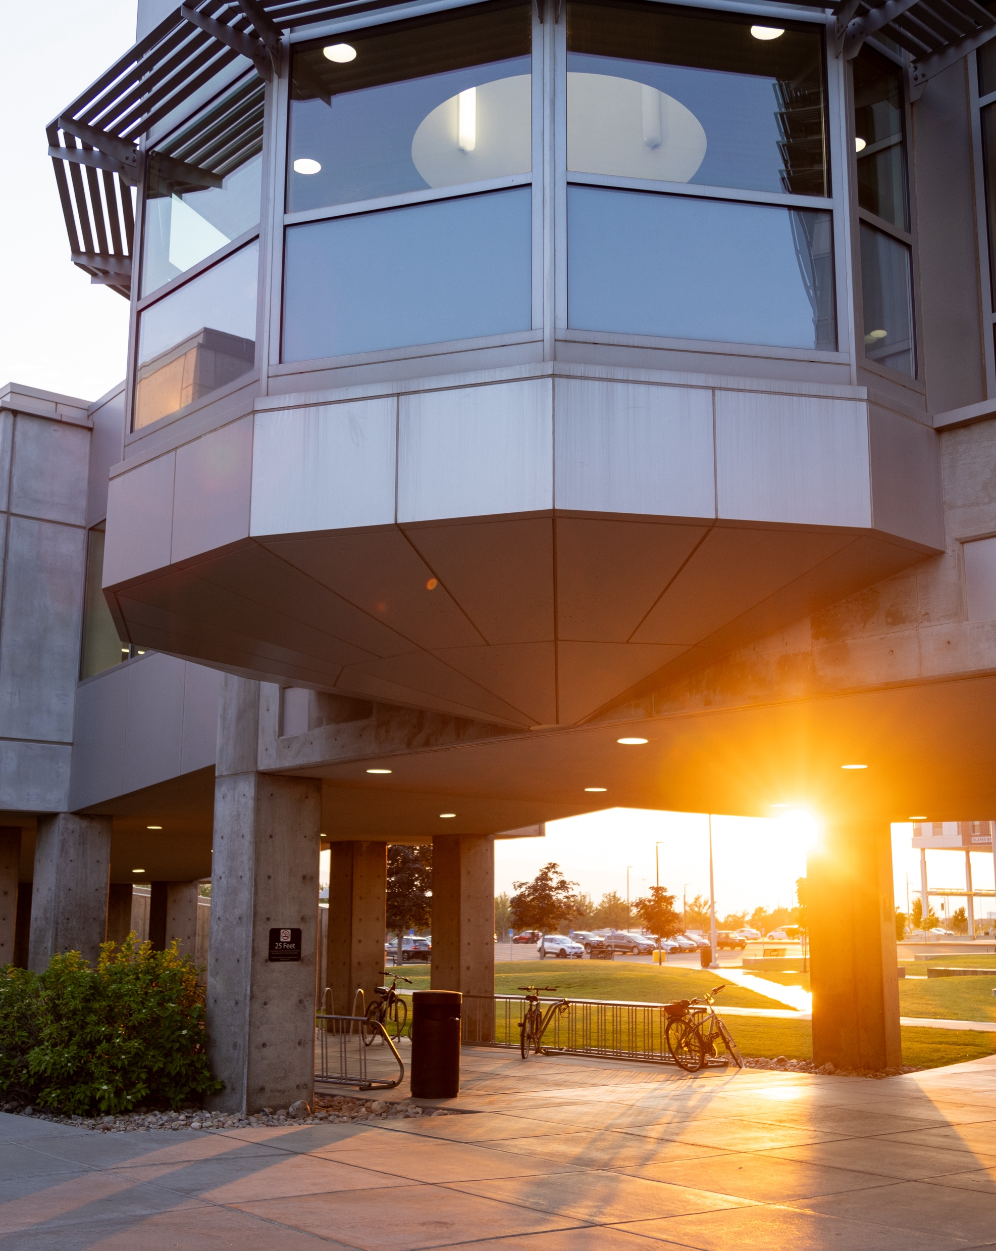
Engaging faculty with advisory board members & industry partners
(Group Discussion)

Slide 9


What do you want faculty to gain from engaging with board members? Be specific!
How can you create formal ways to connect faculty with advisory board work or board members?
How can you foster informal connections between faculty and industry?
What parameters should be drawn around faculty engagement with advisory boards?
*
*
*

Slide 10


INVOLVING BOARDS IN CURRICULUM REVIEWS & PROCESSES
A Real Tension- Role of CE
Understanding Needs
Externships and Projects
Build Trust
Consistent Interaction- understanding timelines

Slide 11

Leveraging boards
to ensure
workforce relevance
(discussion)

Slide 12
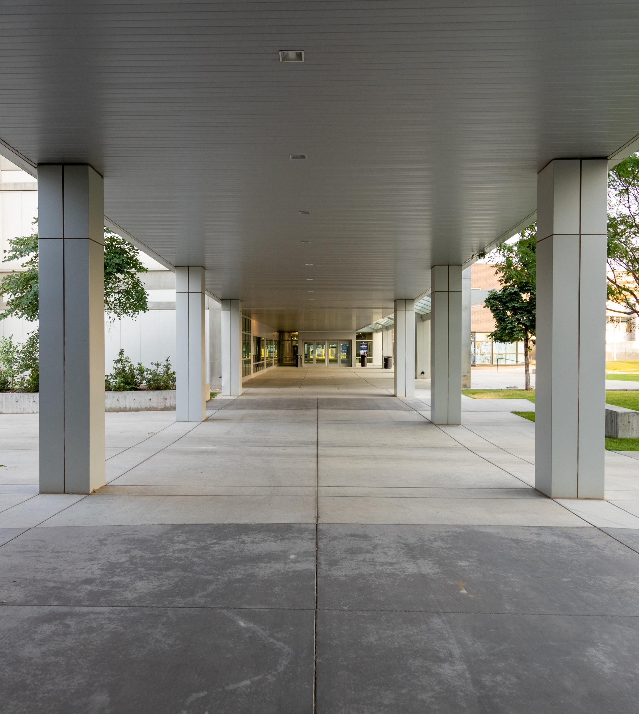
UVU Workforce-Ready Efforts
Student internships, faculty externships, project-based learning, e2i, service-based learning, industry guest lectures, job shadows, mentoring, youth summer camps, apprenticeships, K12 outreach, student support services, articulation agreements & MOUs, Continuing Education Units (CEUs), professional development, employer tuition assistance programs

Slide 13

Planning Ahead

Slide 14


2025-26
Program Advisory Board Leadership meetings in September & February
TOPIC SUGGESTIONS?
New Advisory Board Boot Camp for those chartering new boards
Virtual Q&A sessions
PLANNED
PROPOSED
Proposed

Slide 15
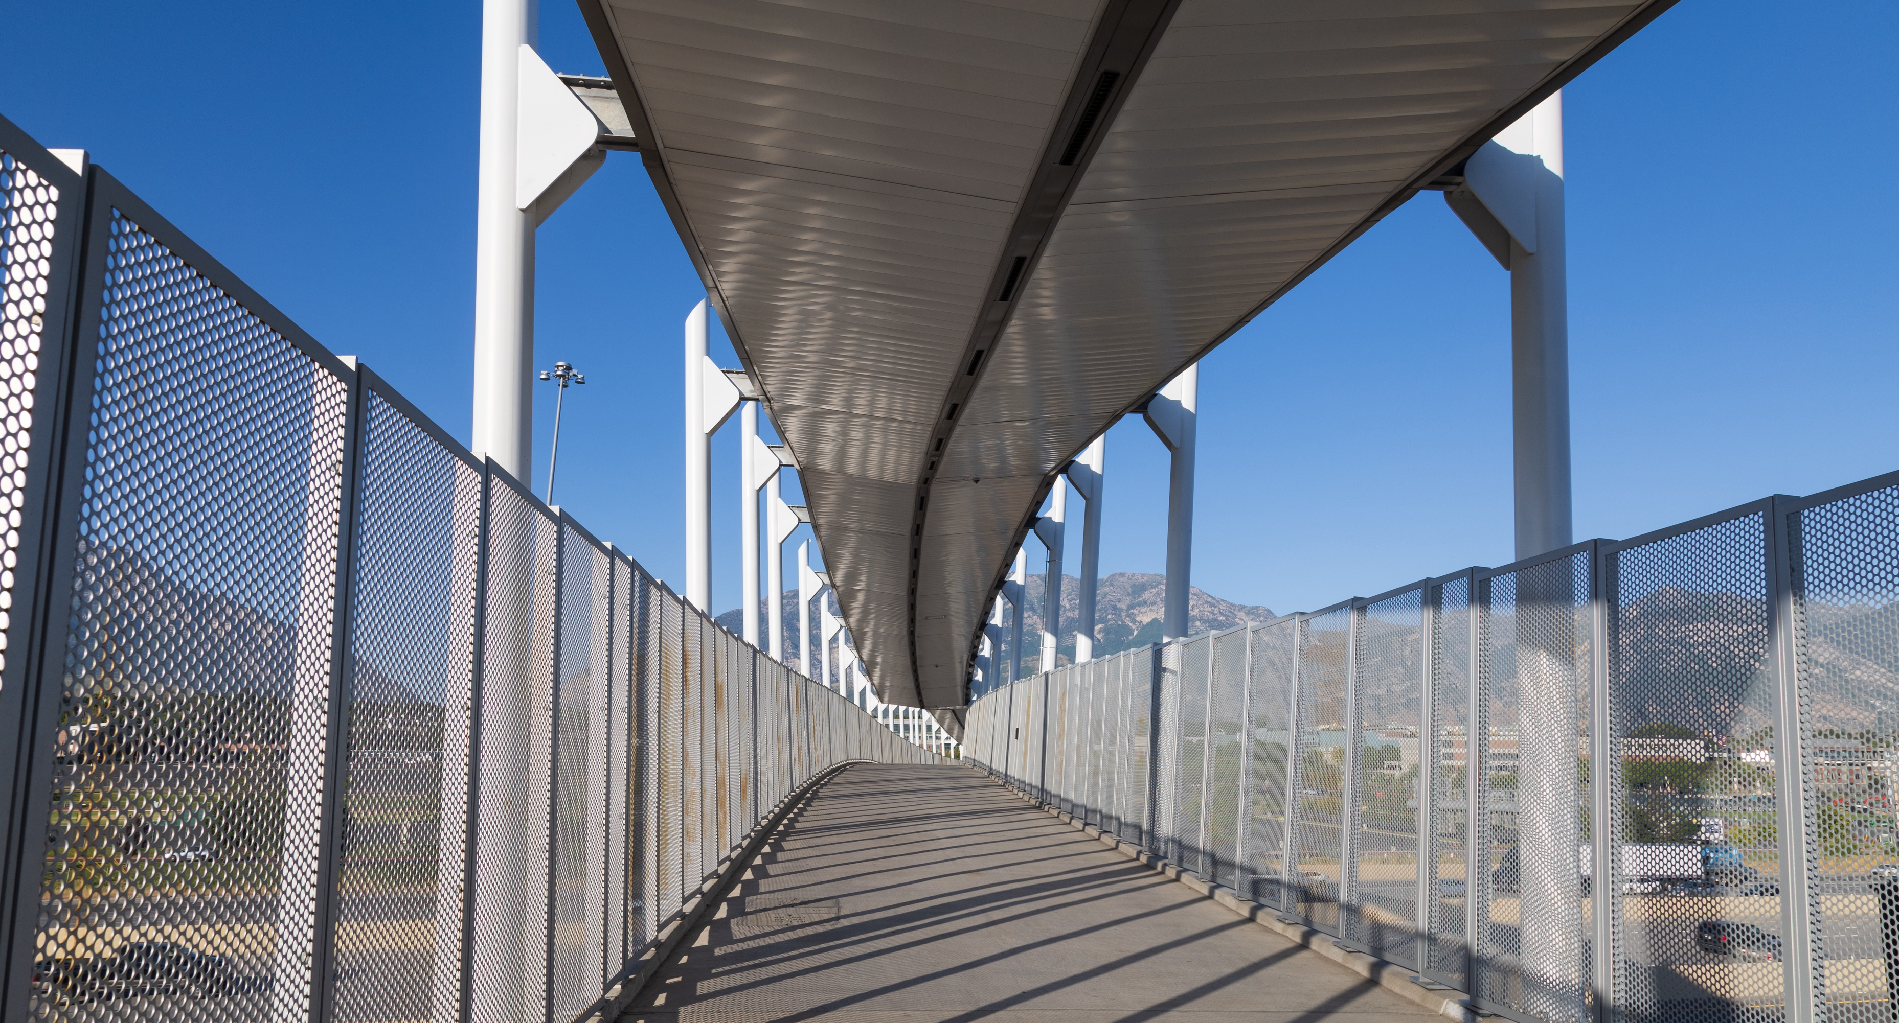
THANK YOU

