Slide 1
Jack Rabbit II Witness Board Data Urban Surface exposures to Chlorine releases
Andy Byrnes – Utah Valley University
Emergency Services
Mark Whitmire – Chemical Security Analysis Center
Dept. of Homeland Security

Slide 2
What is the objective?
Determine the behavior of common building components and urban surfaces. To what degree do common building materials and urban surfaces react with liquid and/or ultra-high concentrations of industrial Chlorine. Specifically, determine the behavior of both new and aged asphalt when in contact with high concentrations of chlorine or liquid chlorine due to the ubiquitous nature of asphalt.

Slide 3
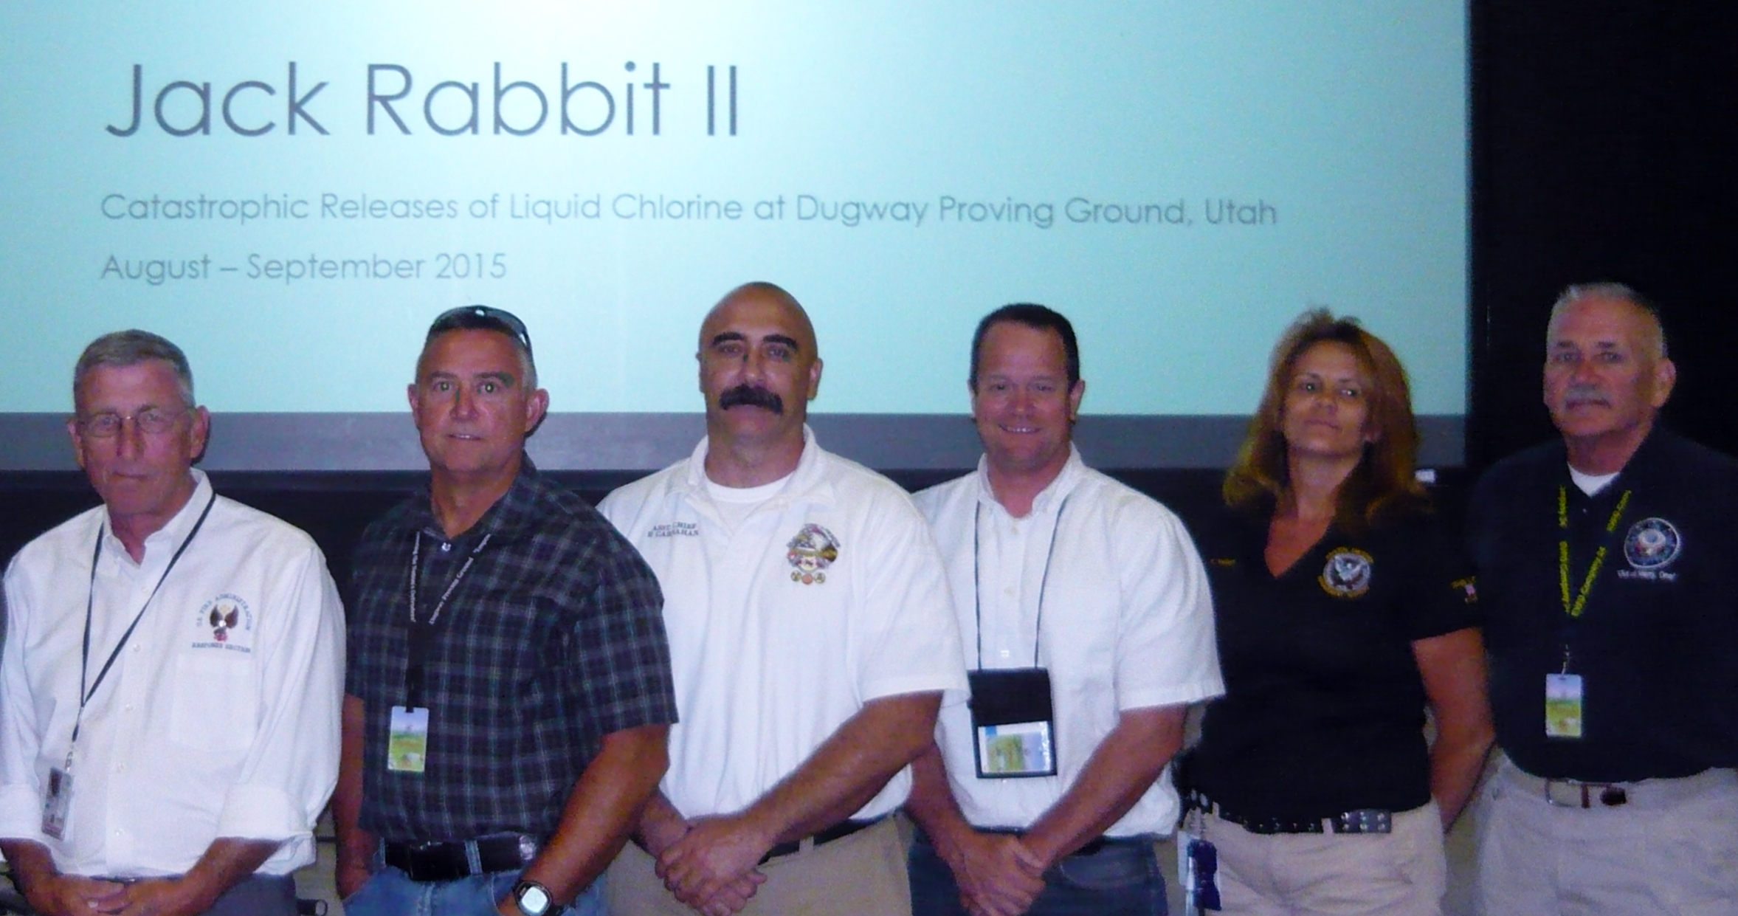
The JR II Dugway Release Team
(L-R) Wayne Yoder – Hazmat Training Program Manager, NFA, Andy Byrnes – Utah Valley University, Chief Patrick Carnahan – DPGFD, David Matthew – Fire Service Researcher, Kelly Wright – DPG Emergency Manager, and Greg Noll – Chair, NFPA 472 & IAB

Slide 4
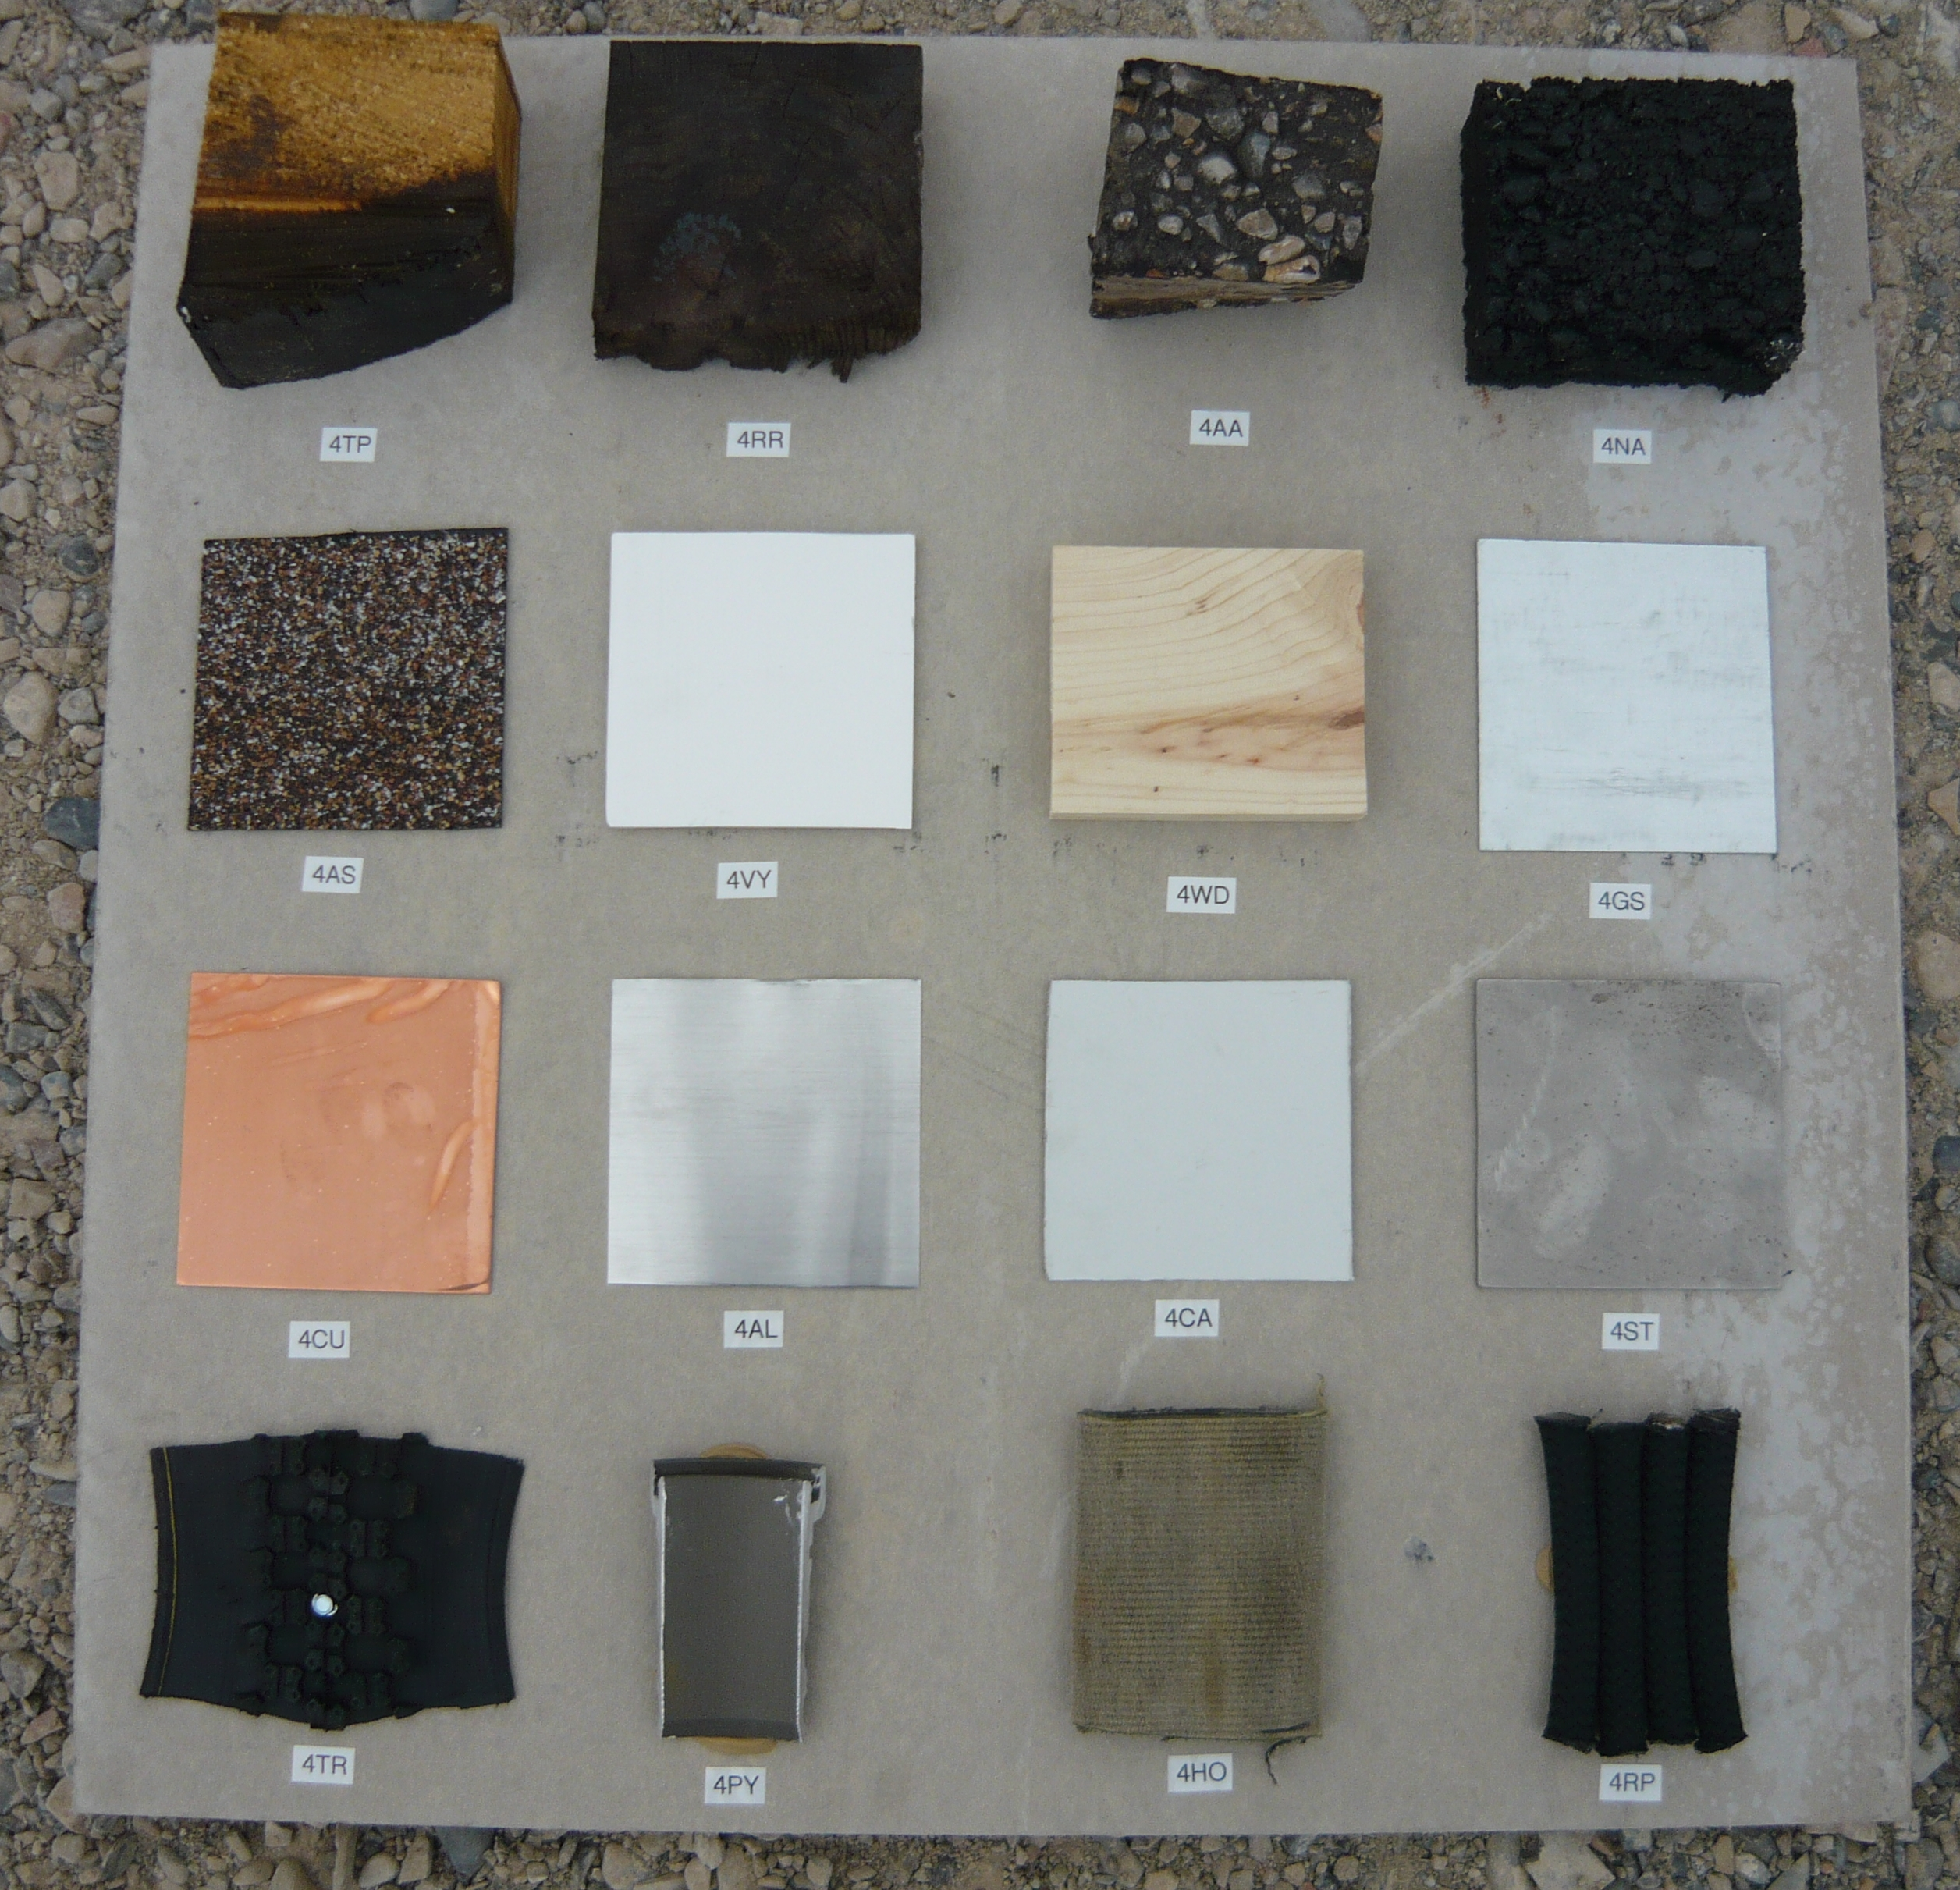
Witness Board representative surfaces
Telephone Pole | Railroad Tie | Aged Asphalt | New Asphalt
Asphalt Shingle | Vinyl Fence | Wood | Galvanized Steel
Copper | Bare Aluminum | Coated Aluminum | Bare Steel
Rubber Tire | Pyrolite Fitting | Nylon Jacketed Fire Hose | Kernmantle Nylon Rope

Slide 5
Typical pre-release photo of witness board (#9)

Slide 6
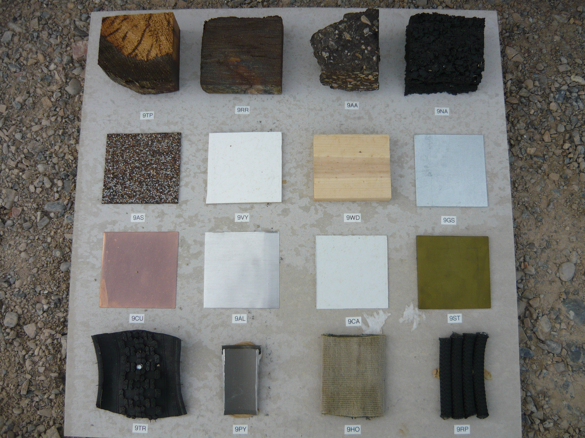
Typical results of Ultra-high concentration of chlorine gas on a witness board (#9 – Rel. 5)
200,000+ ppm

Slide 7
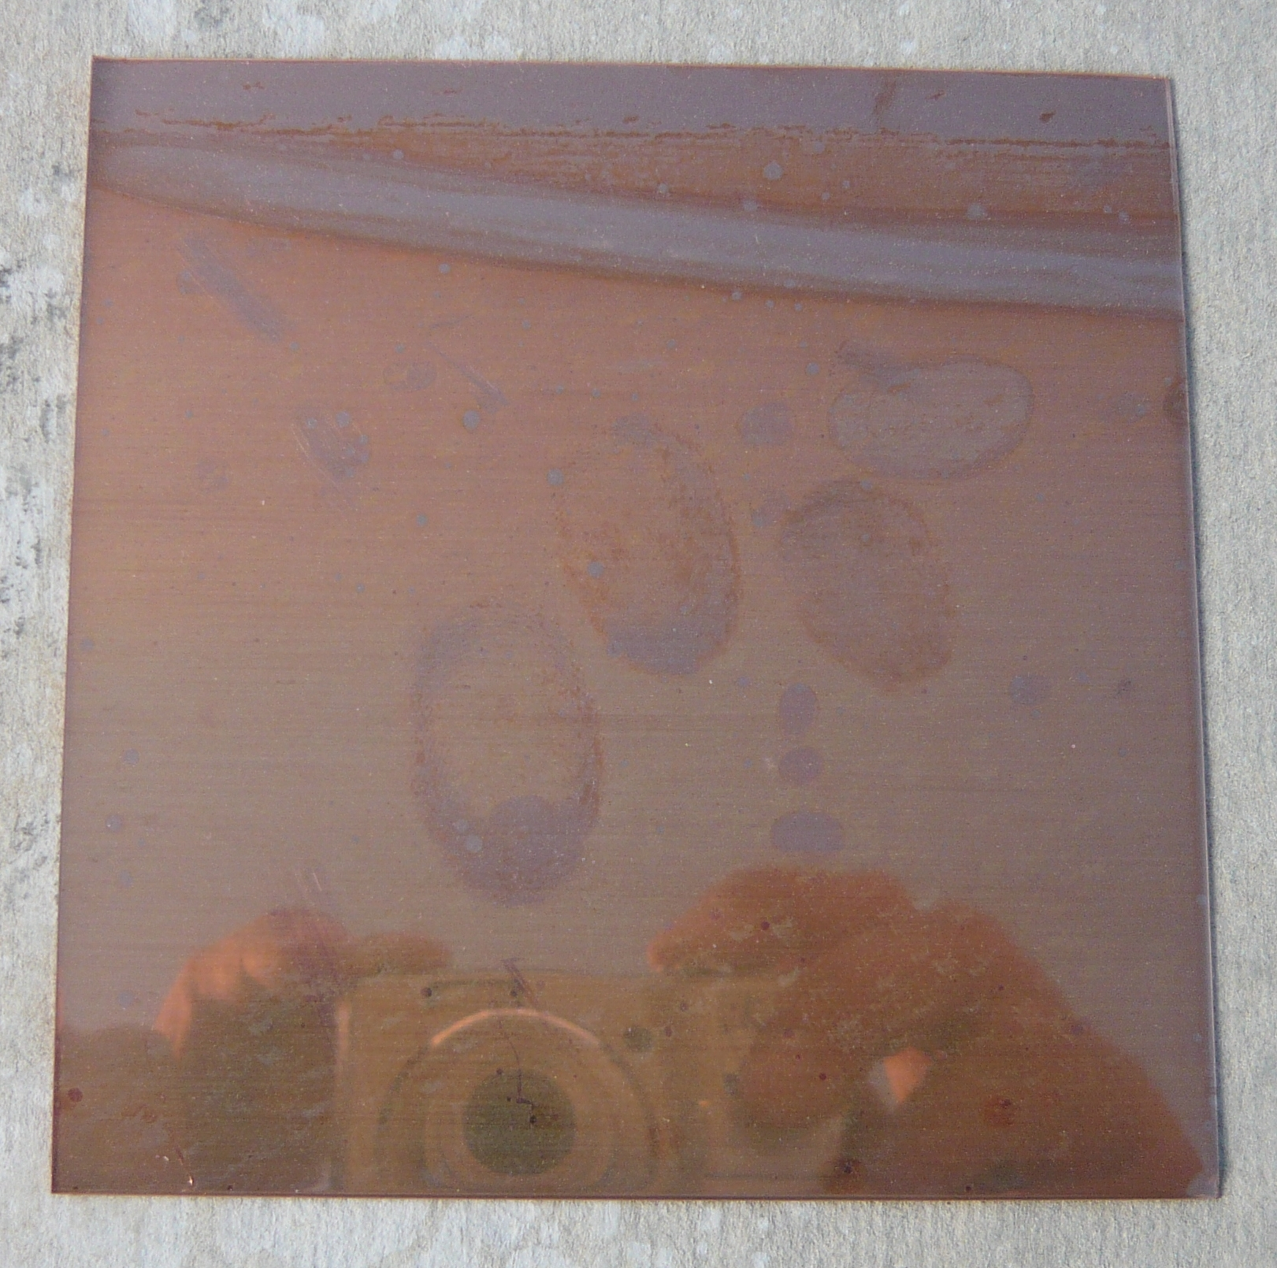
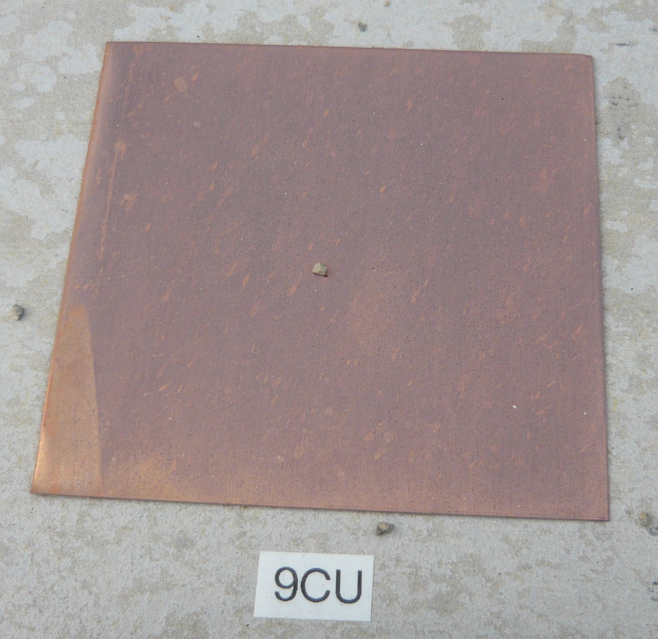
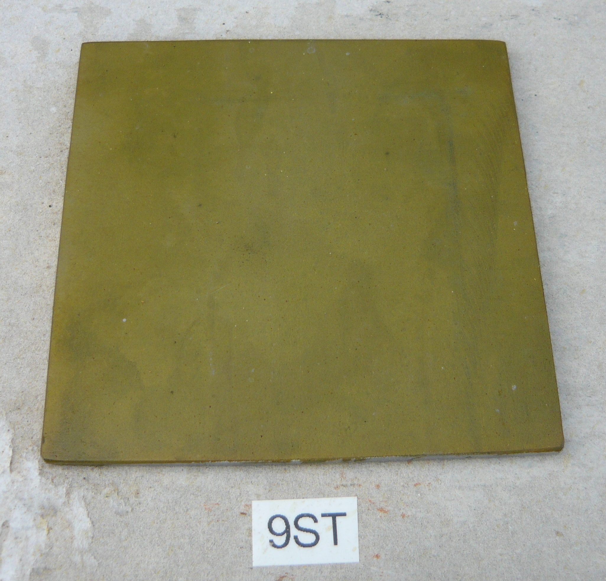
Copper and Steel most effected (typical)

Slide 8
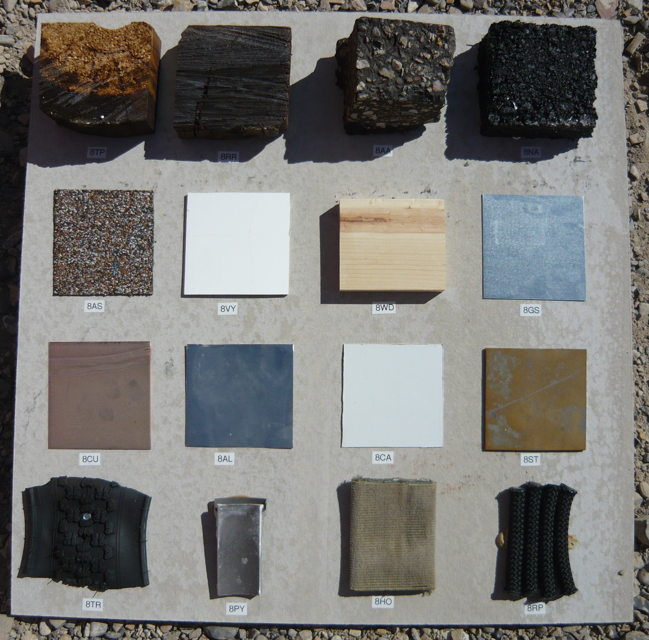
Chlorine gas exposure has Little to no effect on other urban surfaces

Slide 9
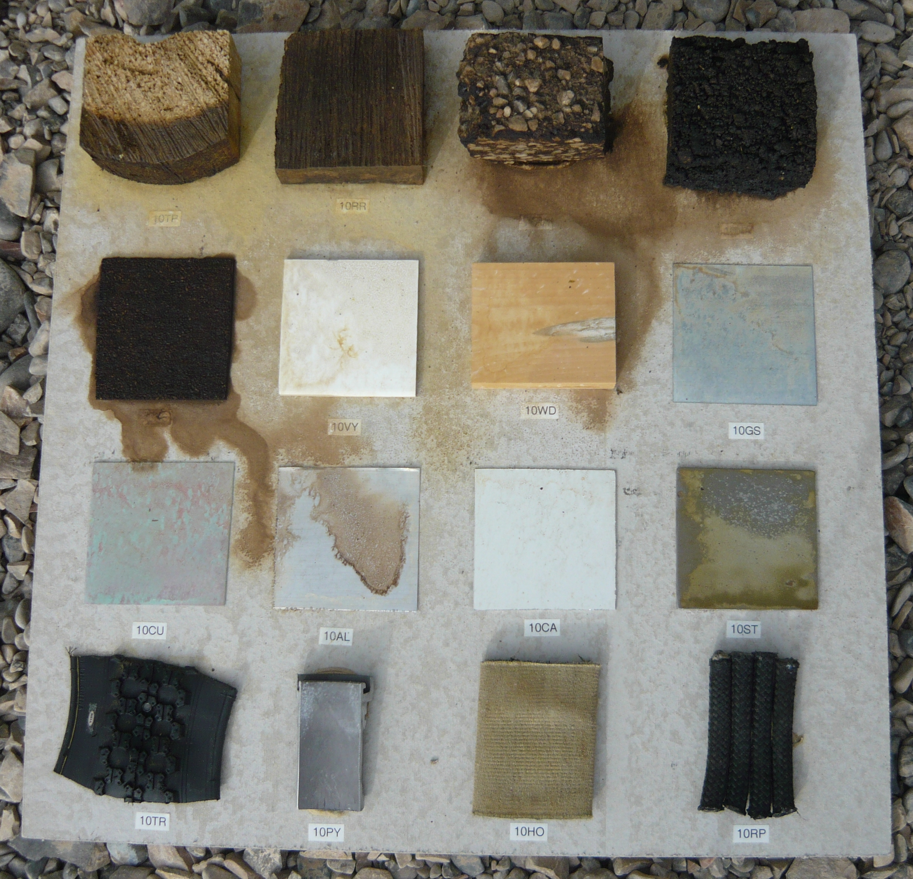
Liquid Chlorine Exposure (#10 – Rel. 5)

Slide 10
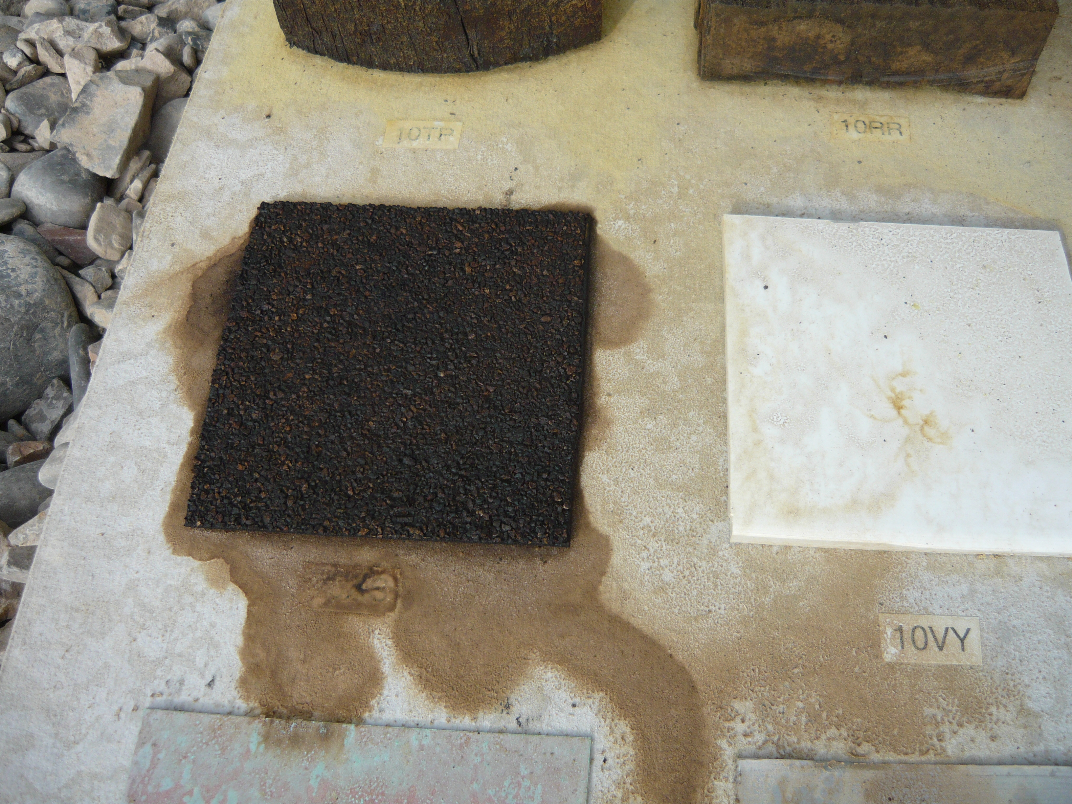
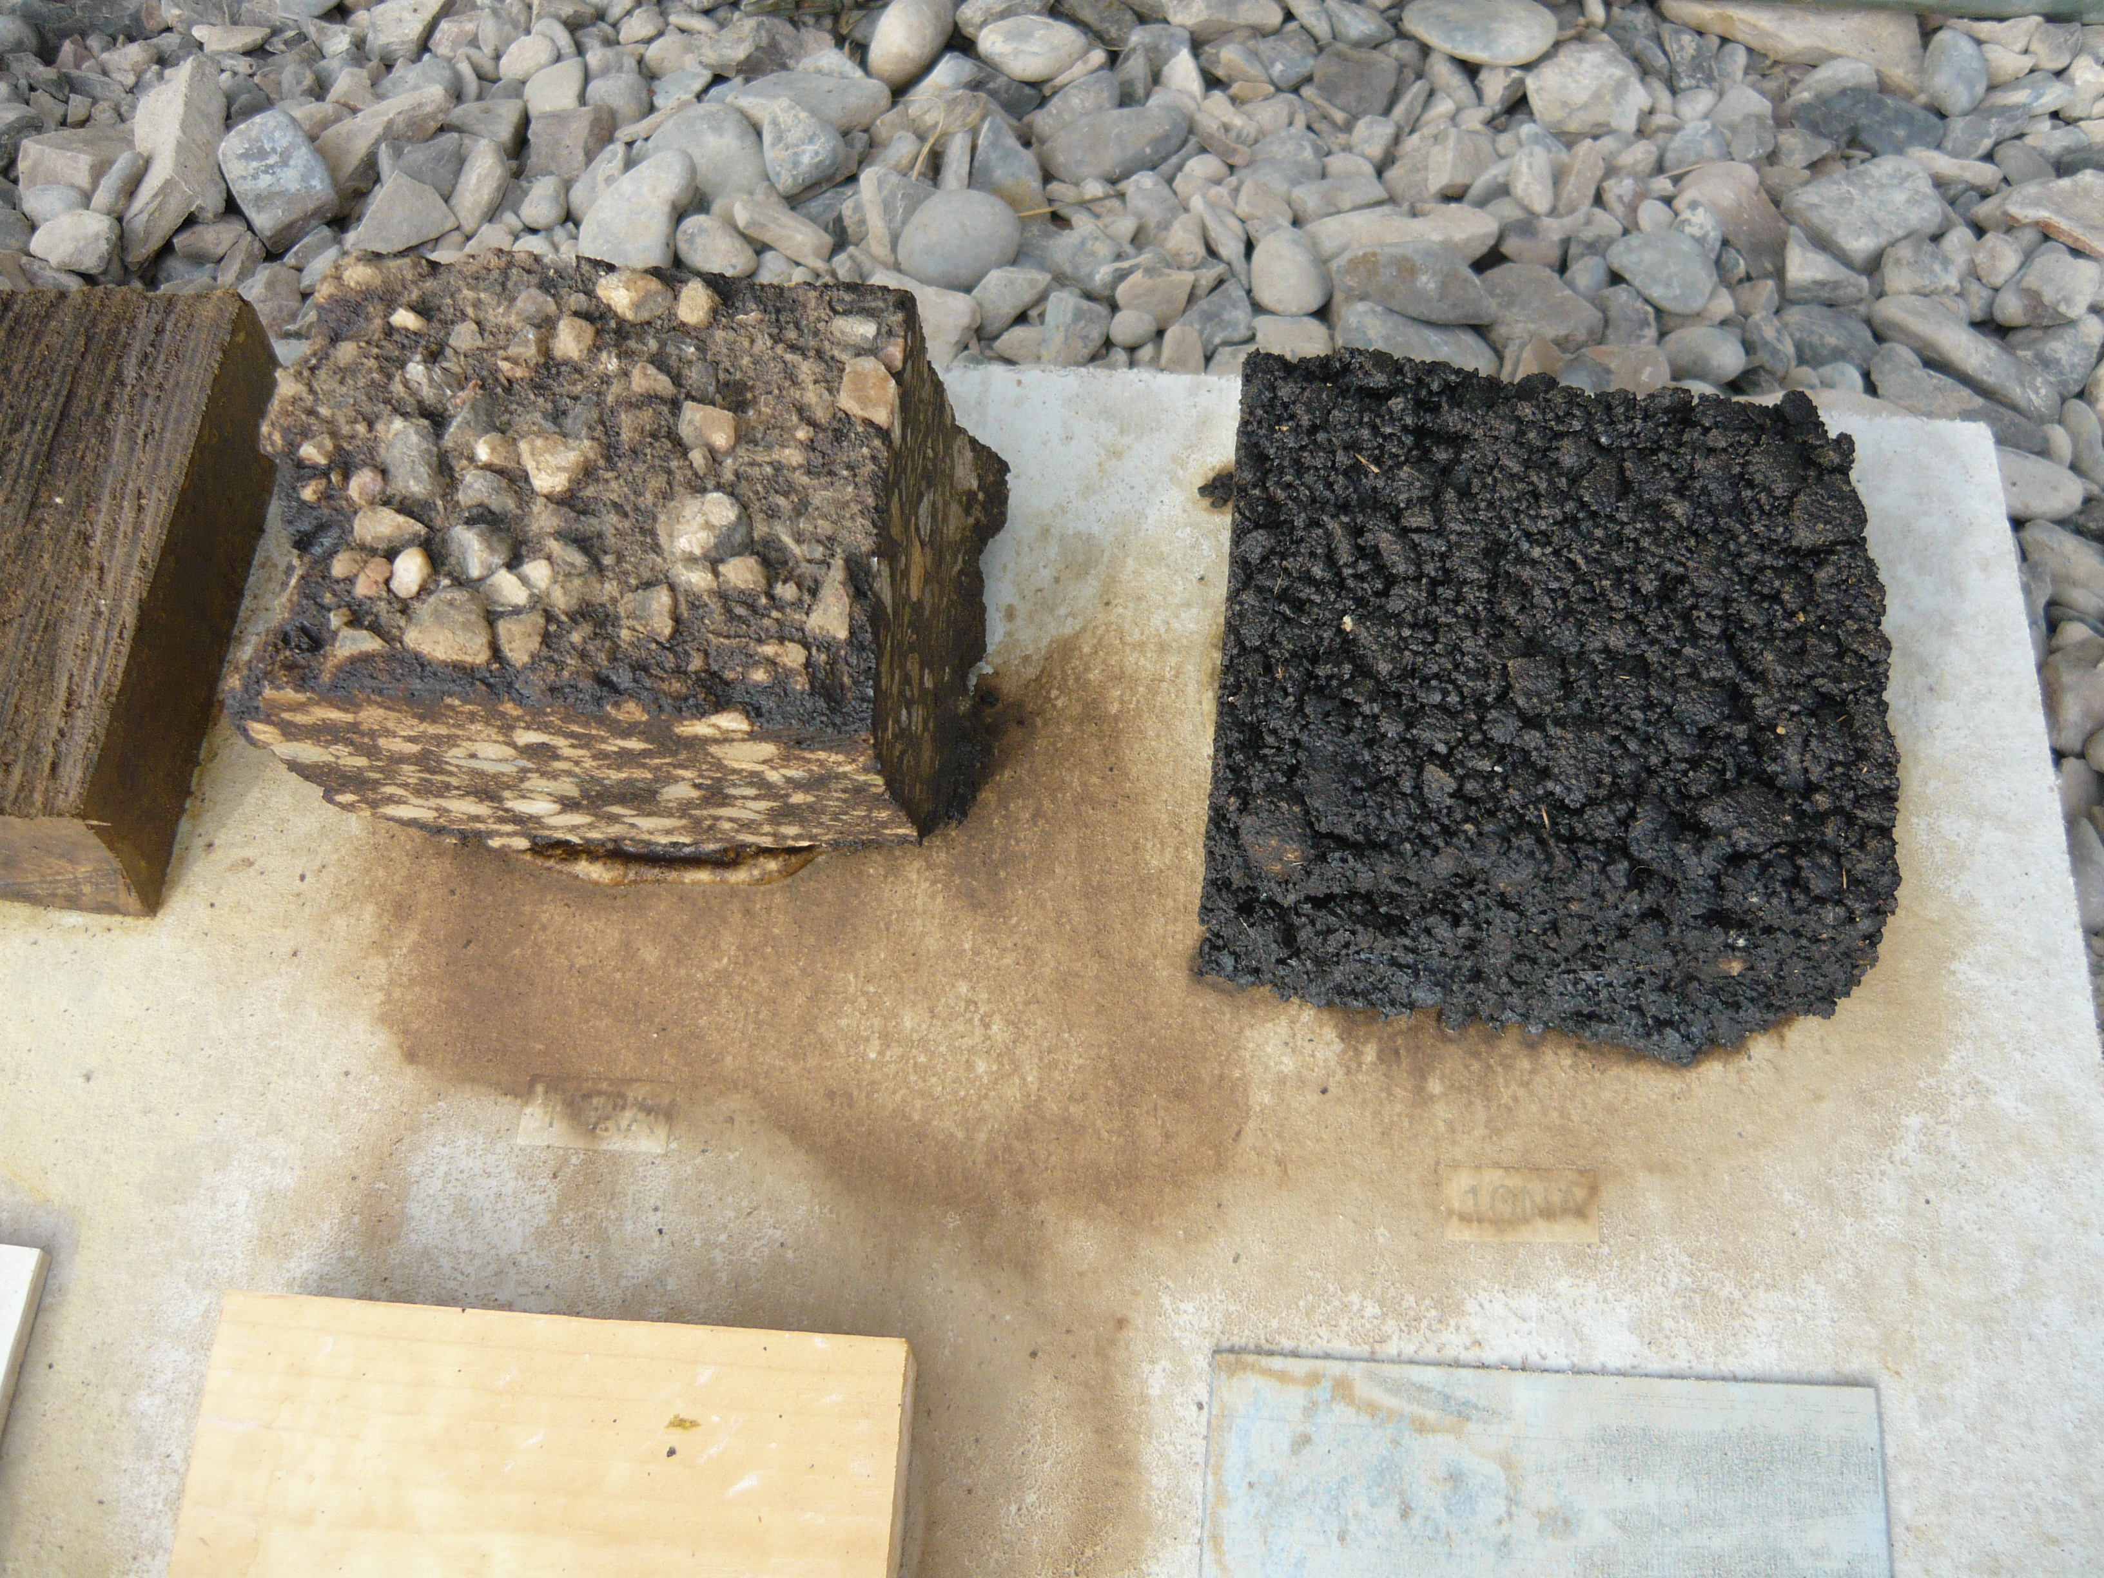
Heavy hydrocarbon dissolves in liquid chlorine exposure

Slide 11
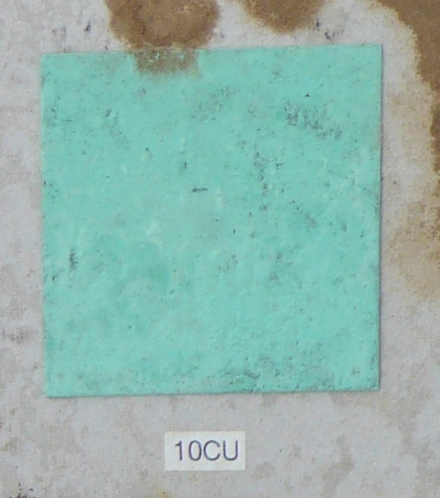
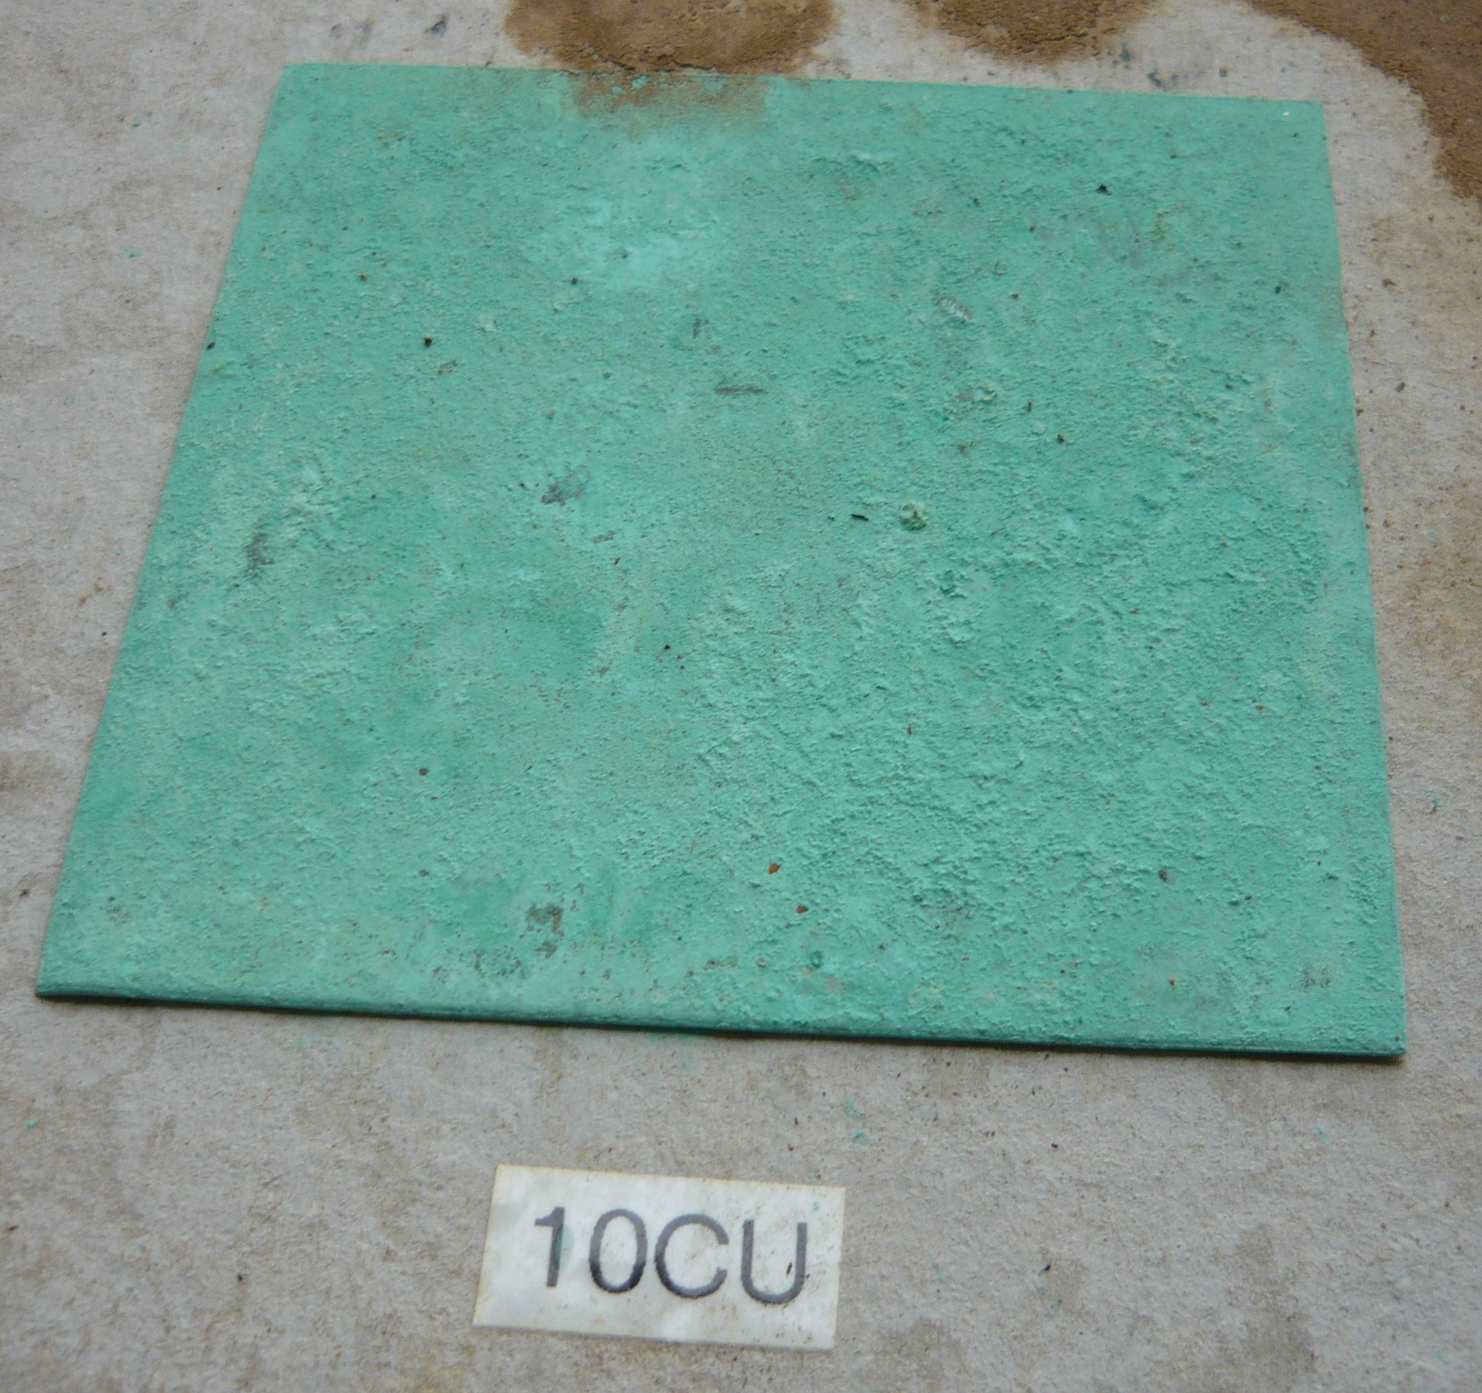
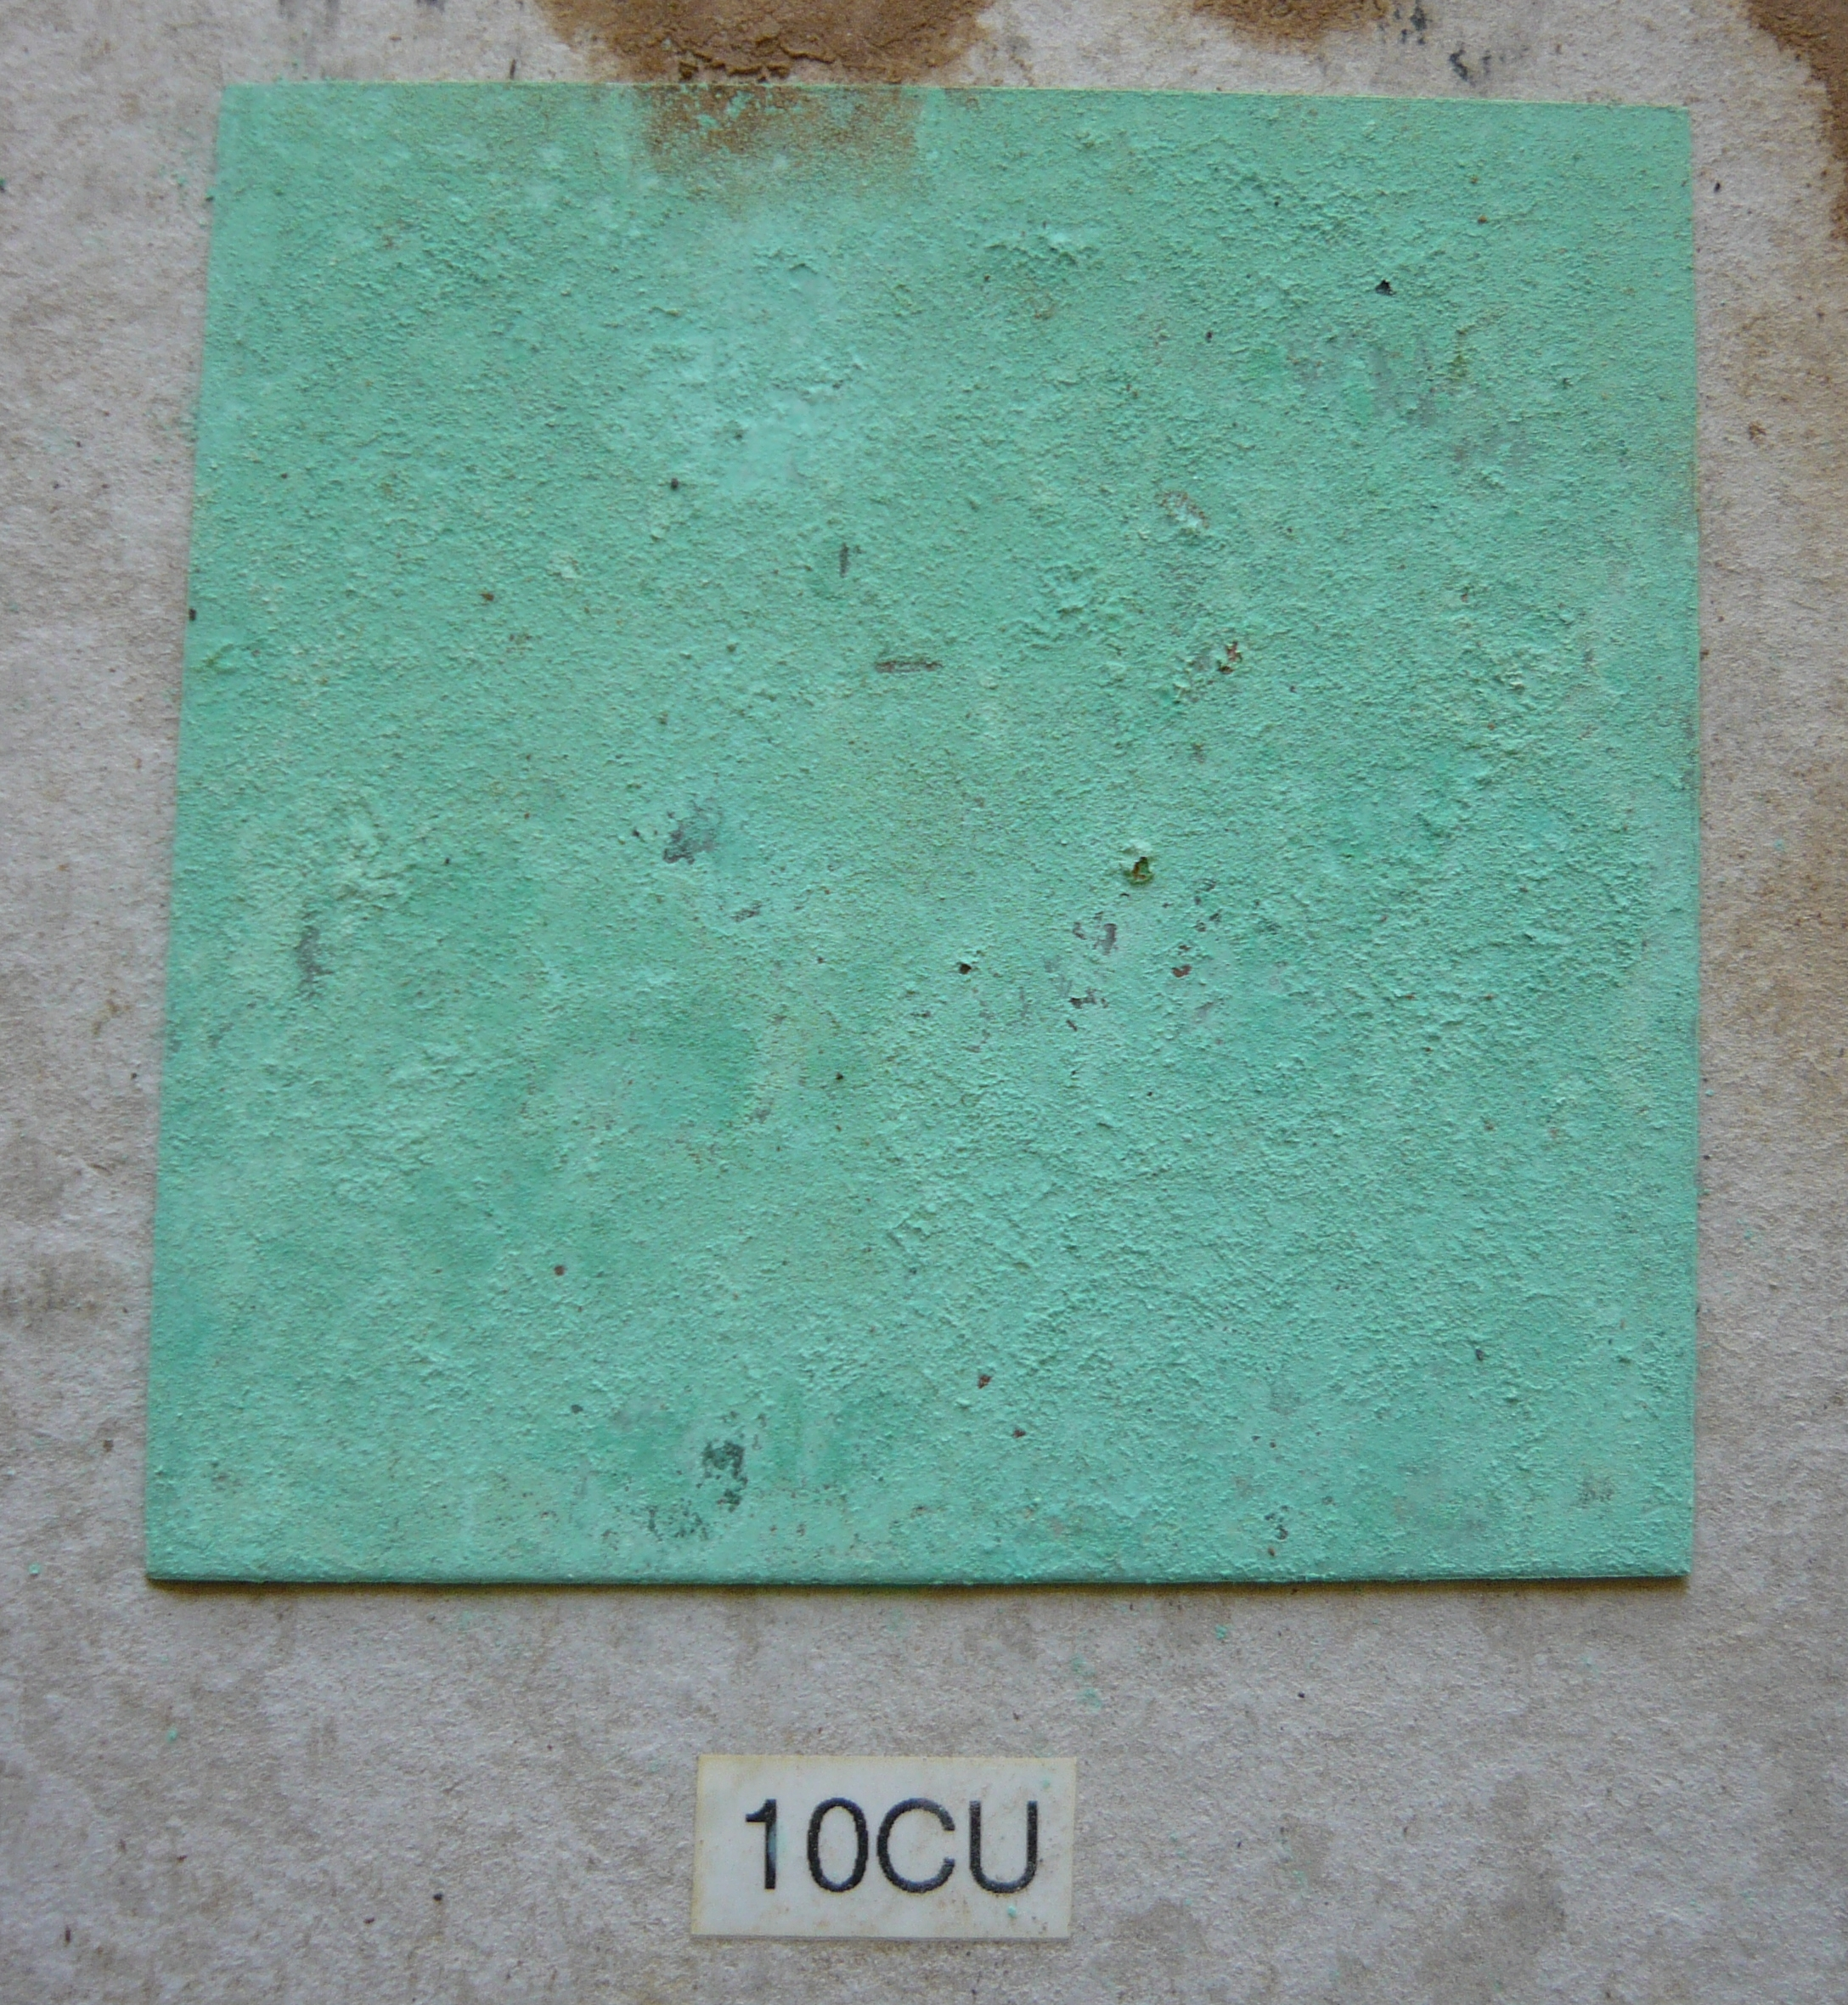
90 day time lapse – Copper #10 – Rel. 5 Liquid exposure
Nov. 2015
Feb. 2016
No observable deterioration over time
May 2016

Slide 12
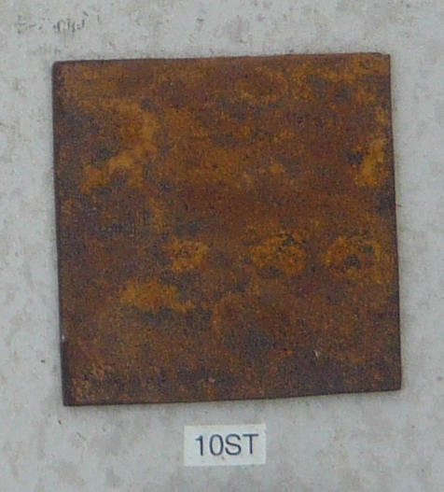
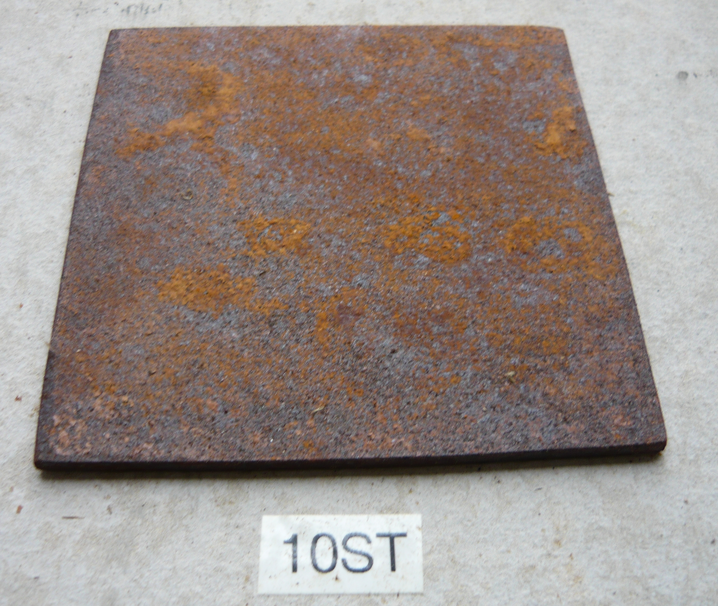
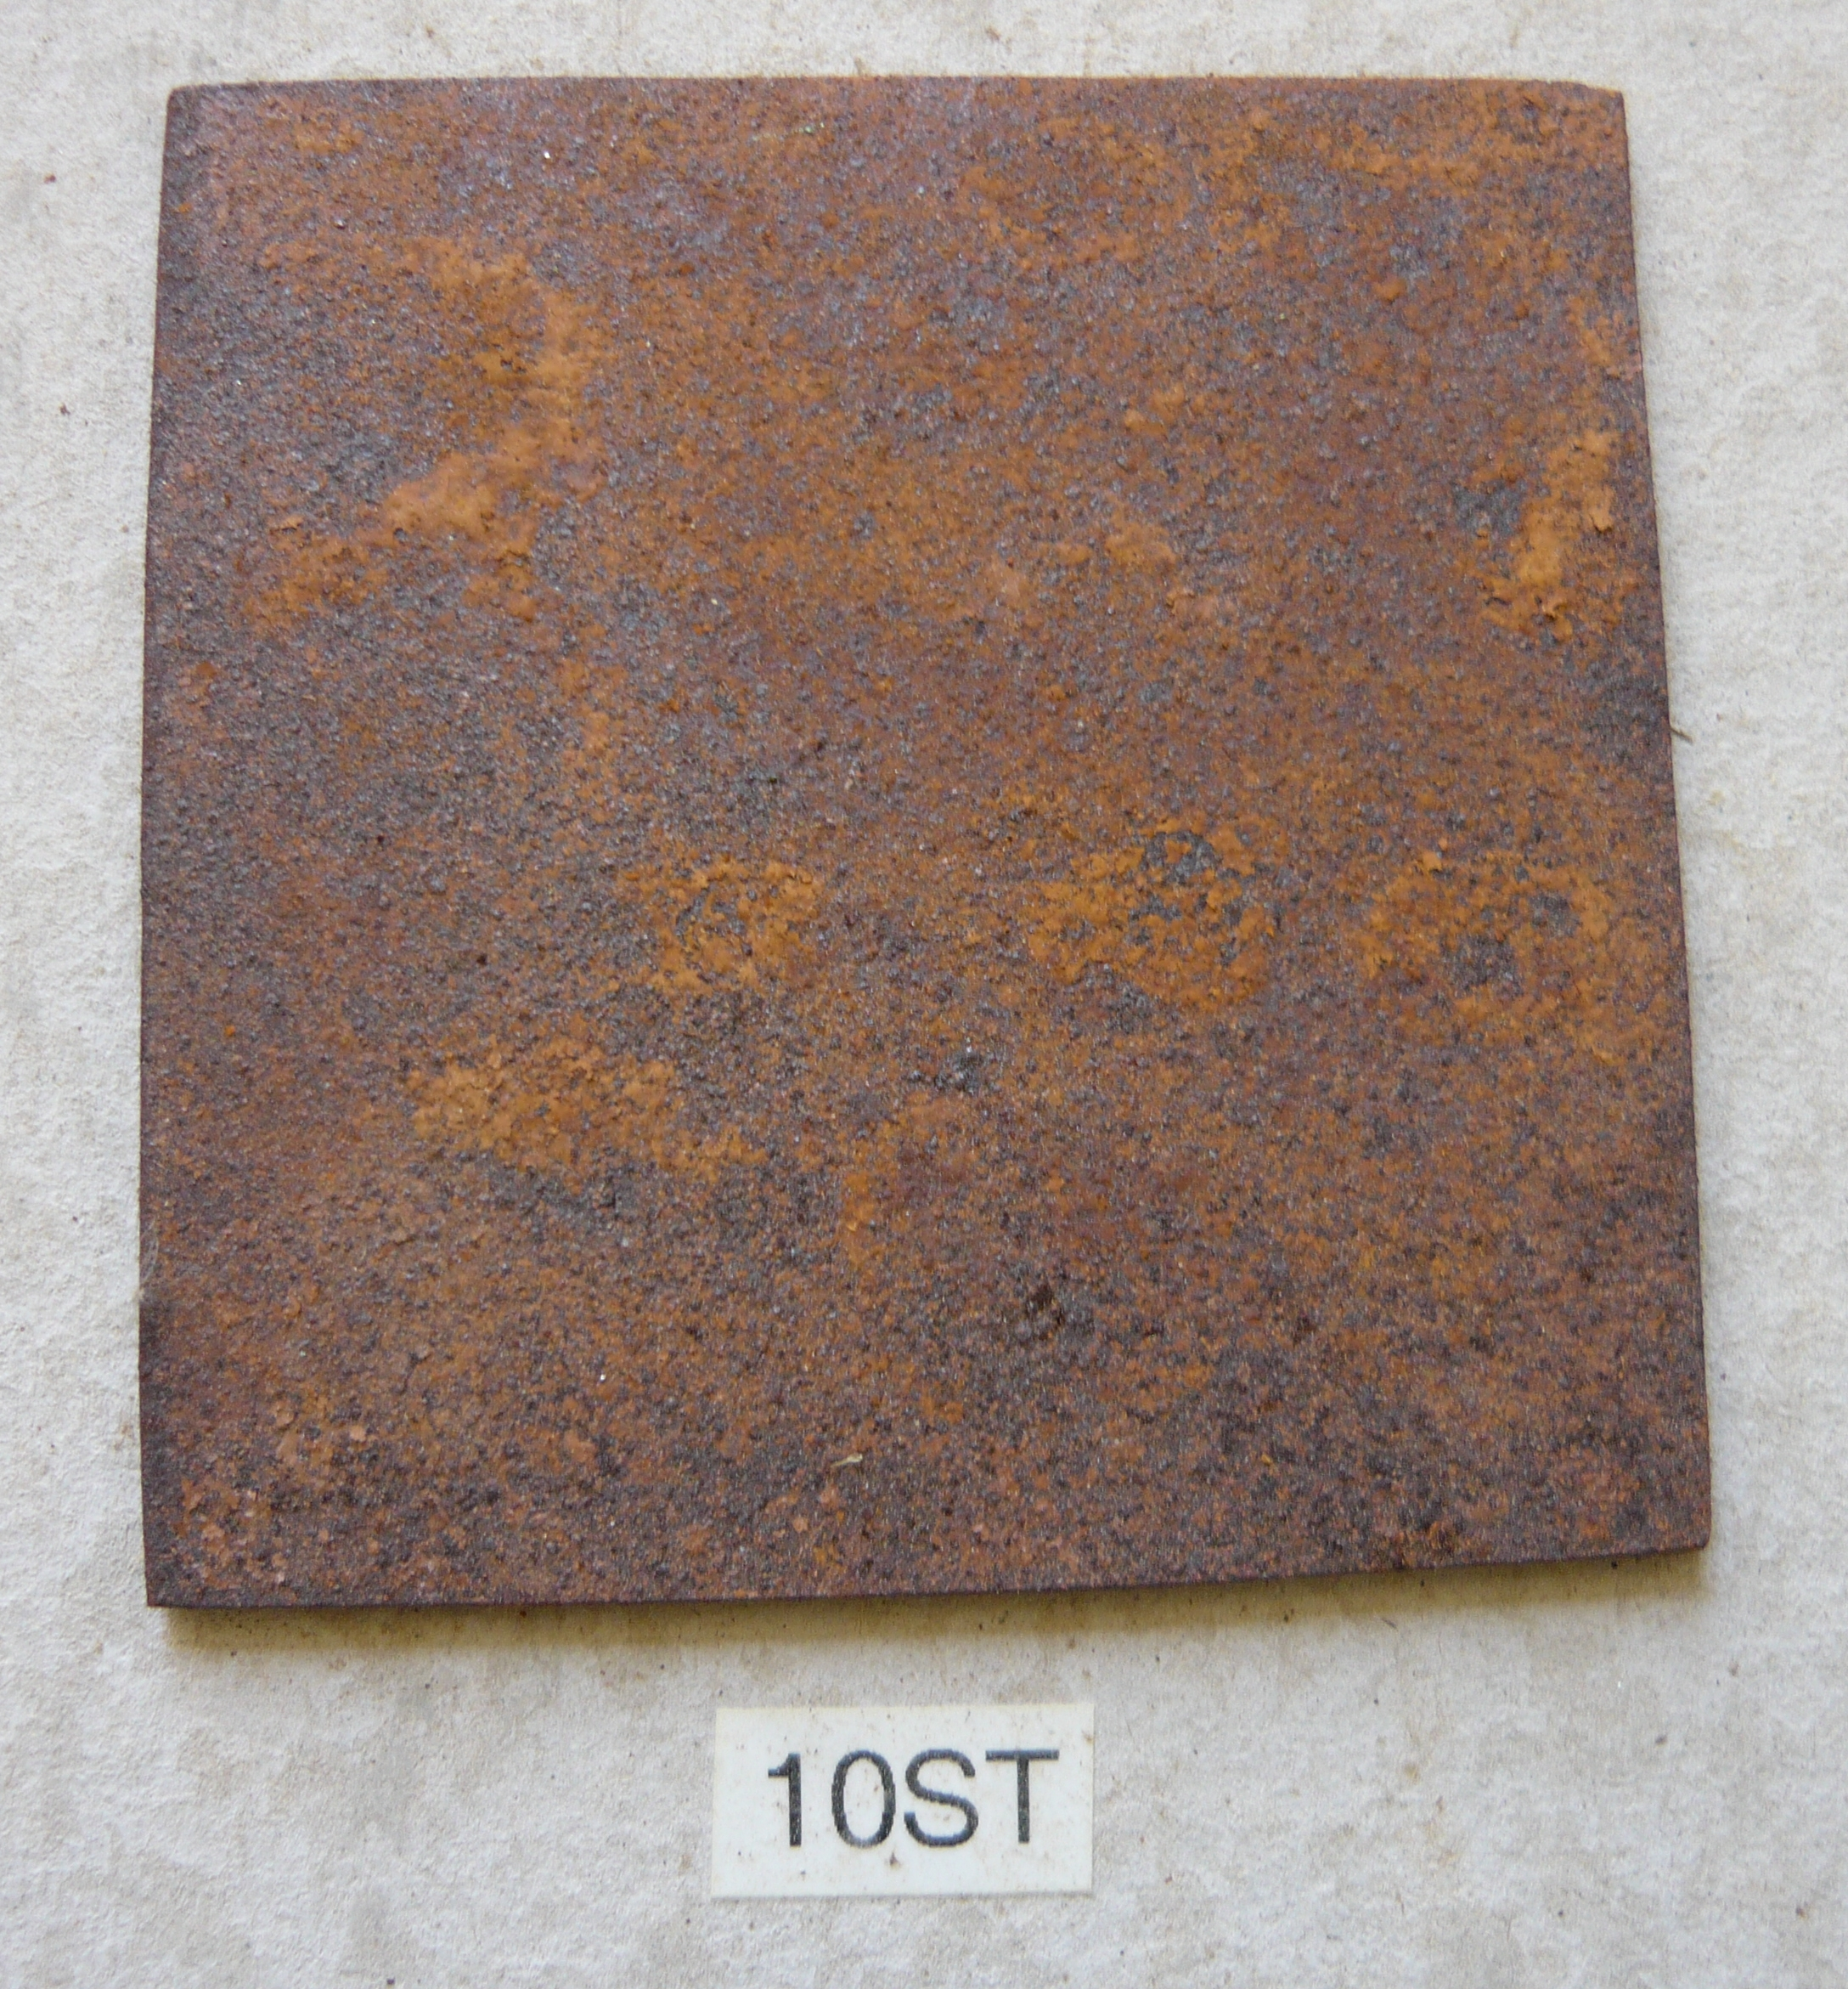
90 day time lapse – Steel #10 – Rel. 5 Liquid exposure
Nov. 2015
Feb. 2016
No observable deterioration over time
May 2016

Slide 13
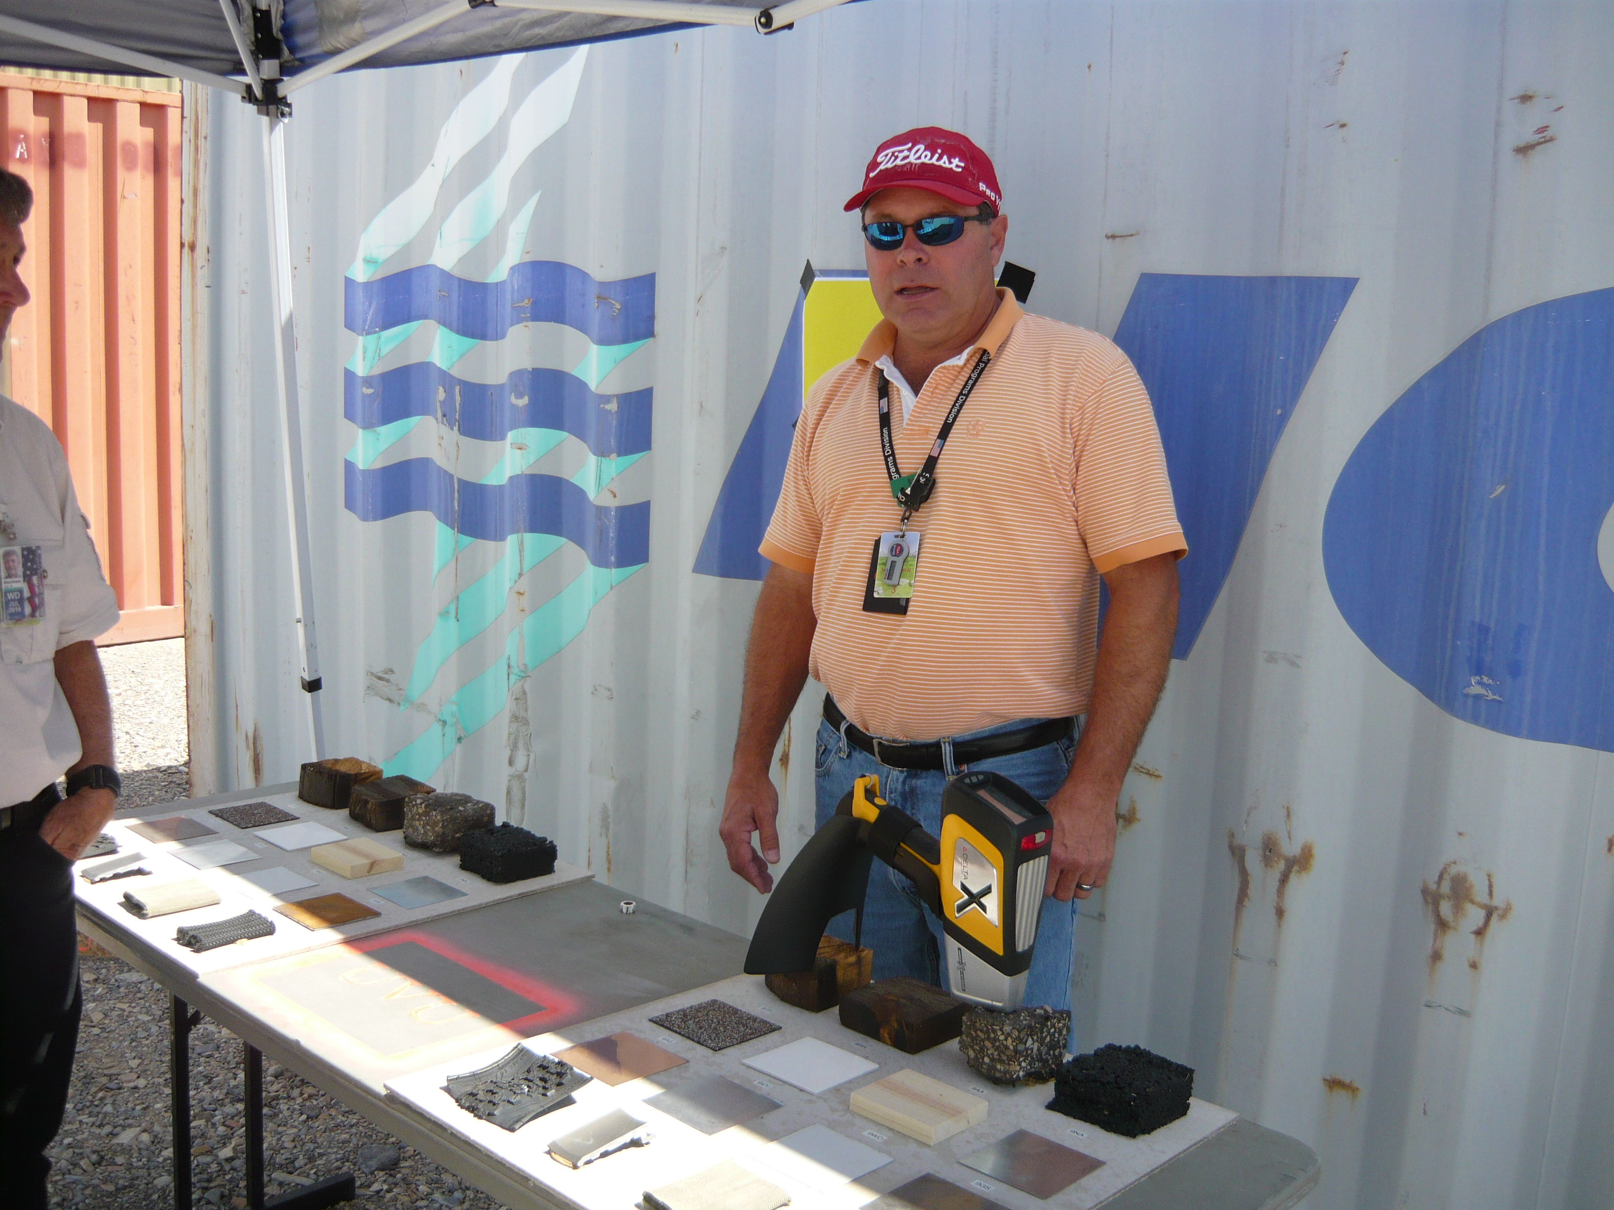
X-Ray Fluorescence Study of urban surfaces
Mark Whitmire – Noblis, Study Prepared for DHS Chemical Security Analysis Center – Aberdeen, MD

Slide 14
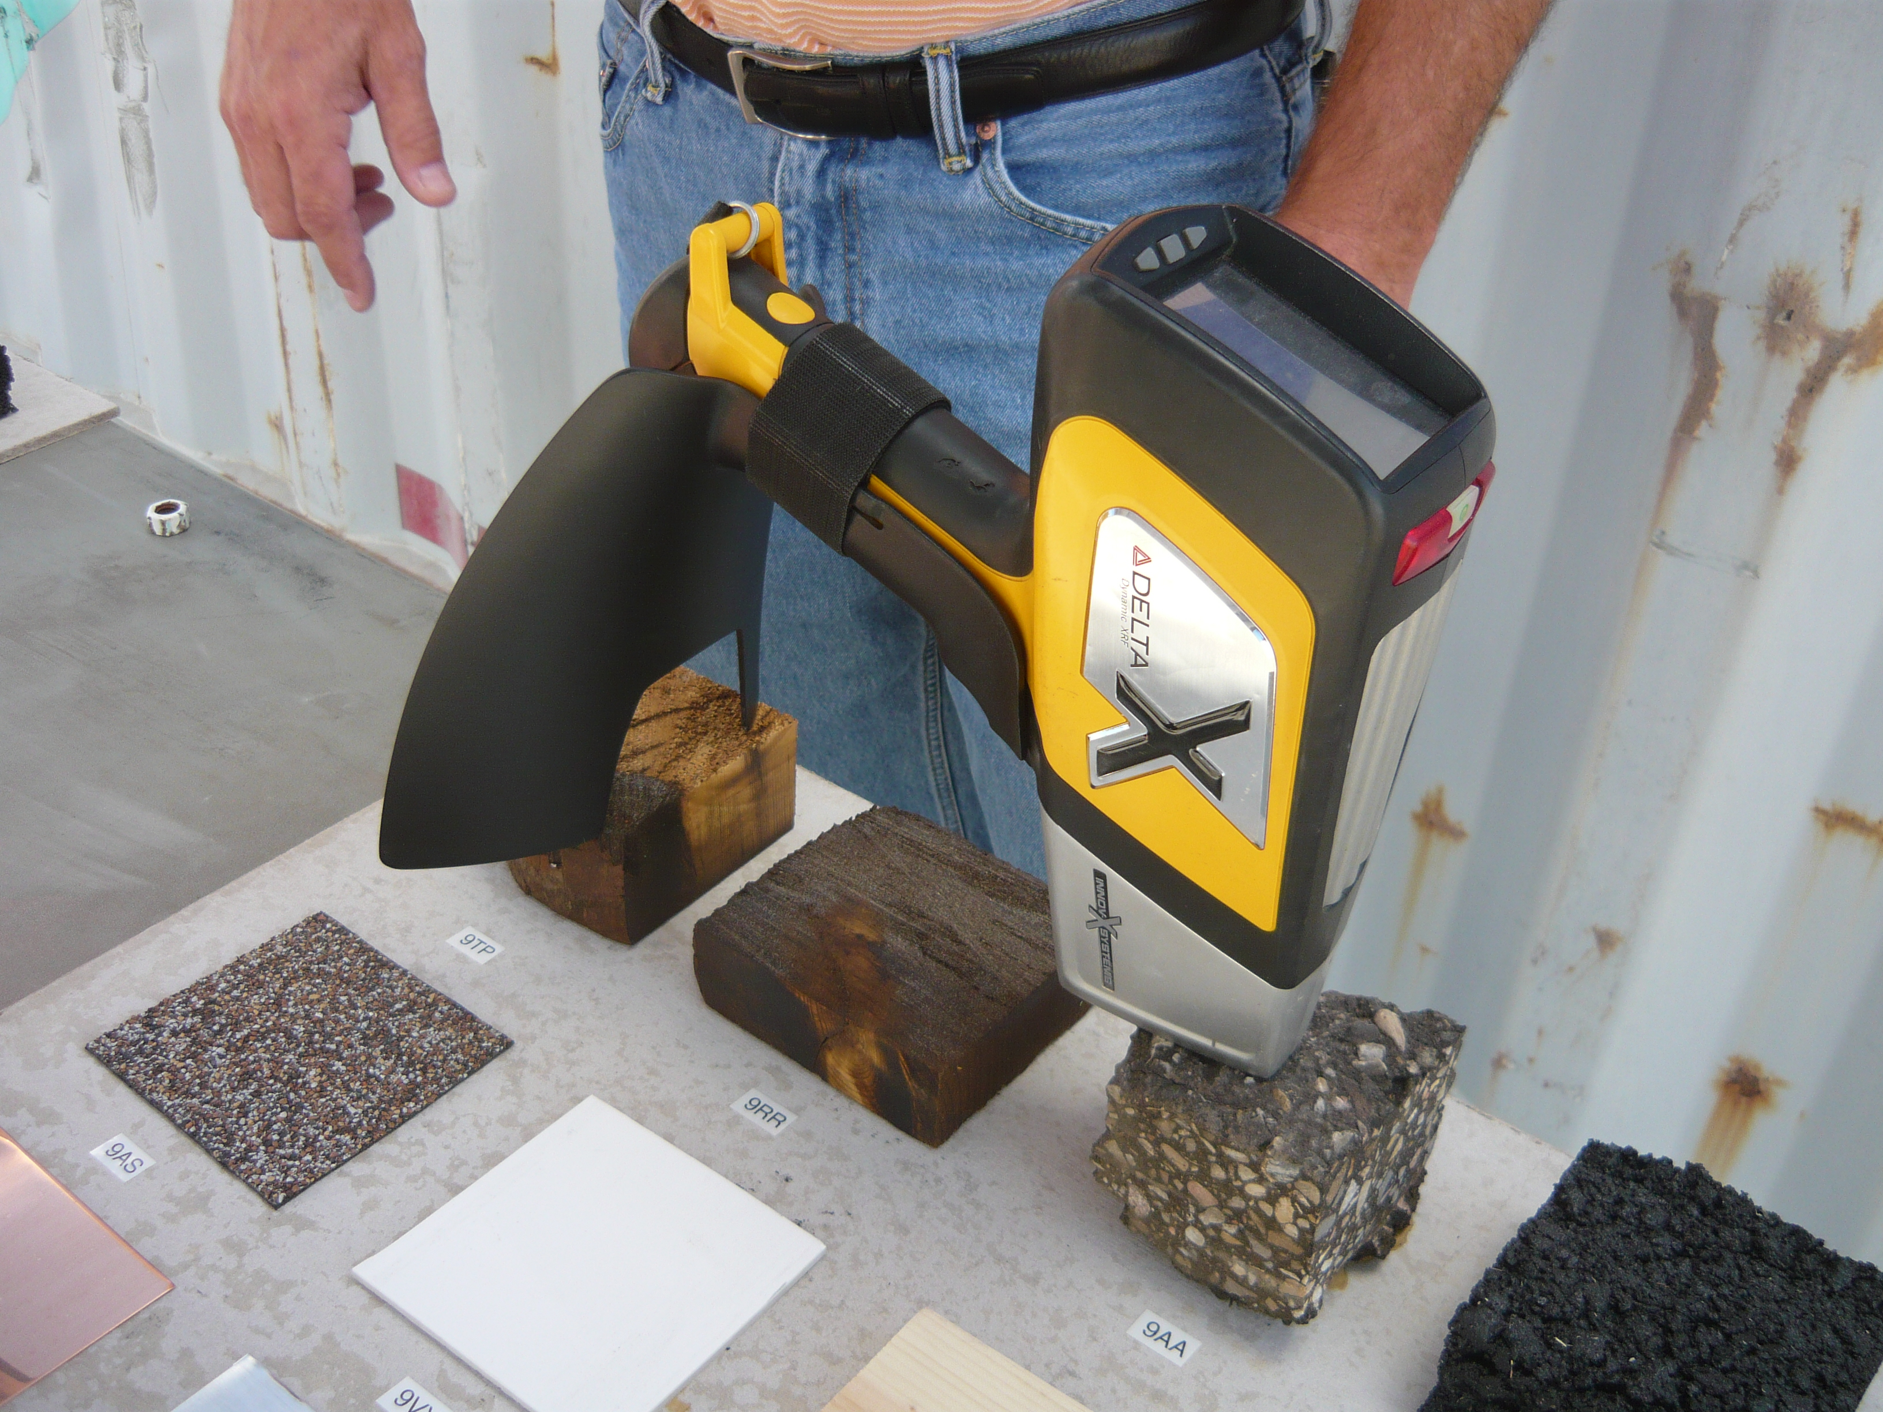
See:
“EVALUATION OF PORTABLE X-RAY FLUORESCENCE FOR THE DETERMINATION OF CHLORINE IN THE ENVIRONMENT AFTER CHLORINE RELEASES AT JACK RABBIT II”
Mark T. Whitmire
John F. Schneider
InnovX Delta® Premium model DP-4000
The XRF uses a sealed radioisotope source to irradiate samples with X-rays. The incident radiation dislodges electrons from the innermost shells of the atom, creating vacancies. The electron vacancies are filled by other electrons cascading down from higher energy electron shells, thus emitting fluorescent energy characteristic of the element [in this case Chlorine].

Slide 15
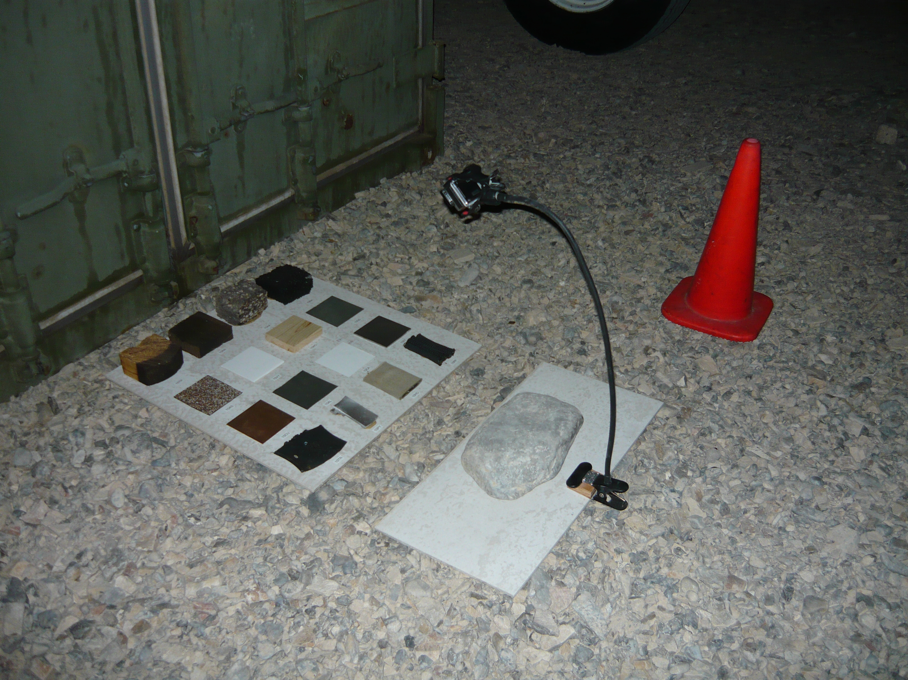
Prepared by:
Andrew Byrnes M.Ed. EFO
Utah Valley University
Emergency Services
3131 Mike Jense Parkway
Provo, Utah 84601
(801)863-7721
byrnesan@uvu.edu

