Slide 1
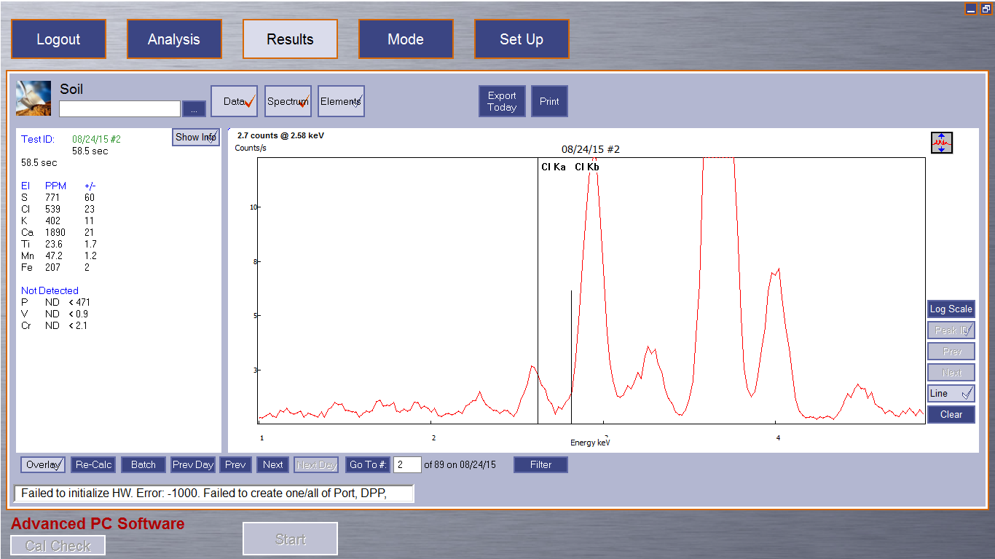
1-TP pre-release analysis. Peak height is 2.7 units tall and corresponds to 523 ppmw Cl, likely from pentachlorophenol preservative. The black vertical lines indicate the x-ray fluorescence energy

Slide 2

The same region in 1-TP, post-release analysis corresponding to about 2000 ppmw

Slide 3
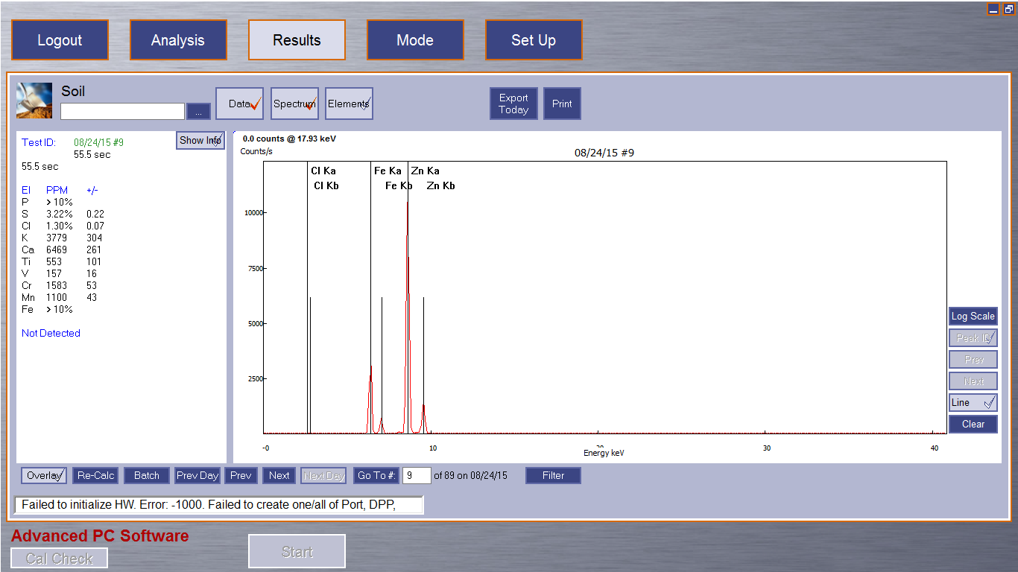
Iron and zinc elements in the galvanized steel, it’s designed to resist corrosion. The next slide shows the details of the chloride region.
Interestingly, the default method reports very high concentrations of chloride (1.30%), but it is an error. The result seems to be typical of highly reflective metal surfaces, at least in these experiments.

Slide 4

Detail of the chloride region of the spectrum in the galvanized steel sample 1-GS, pre-release.

Slide 5
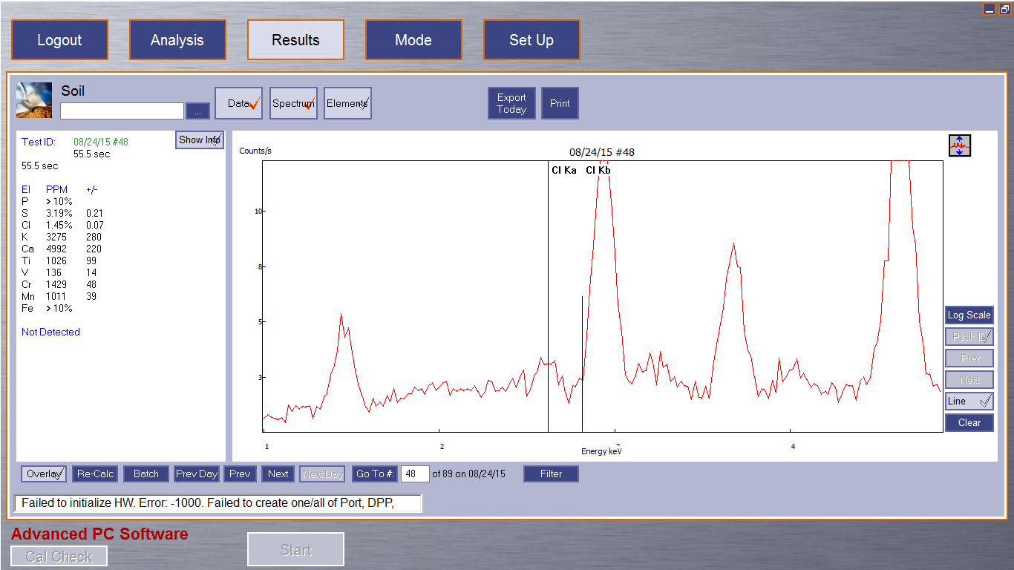
The same region post-release in the same sample 1-GS. There is a hint of chlorine, so the experiment is a good demonstration of the effectiveness of galvanizing.

