Slide 1
Samples for PBA Template Slides

Slide 2
PBA Conversation Outline
1 Priorities: WHY are these the priorities?
2 Accountability: WHAT have you accomplished with your resources?
3 Plans
4 Resource Request
Finances—Resources, expenditures, carryforward, trends, reallocations
Completion, Quality, Efficiency, and other meaningful measures
What is needed?
How can it be funded?
Summary Slide
What is the anticipated impact/outcome?

Slide 3
PBF Finances and Impact
Non-appropriated includes
Campus Store
Dining Services
Print Services
Payment Plan Service Fees
Procurement Services
Surplus Sales
Warehouse
Mail Services
 | Appropriated | Non-Appropriated | Total
VPPBF | $520,405 |  | $520,405
Finance | $5,380,450 | $9,227,707 | $14,608,157
Budget Office | $260,738 |  | $260,738
University Planning & Effectiveness | $228,409 |  | $228,409
Internal Audit | $426,381 |  | $426,381
Policy Office | $193,564 |  | $193,564
Total | $7,009,947 | $9,227,707 | $16,237,654

Slide 4
PBF Finances—Appropriated (91% personnel)

Slide 5
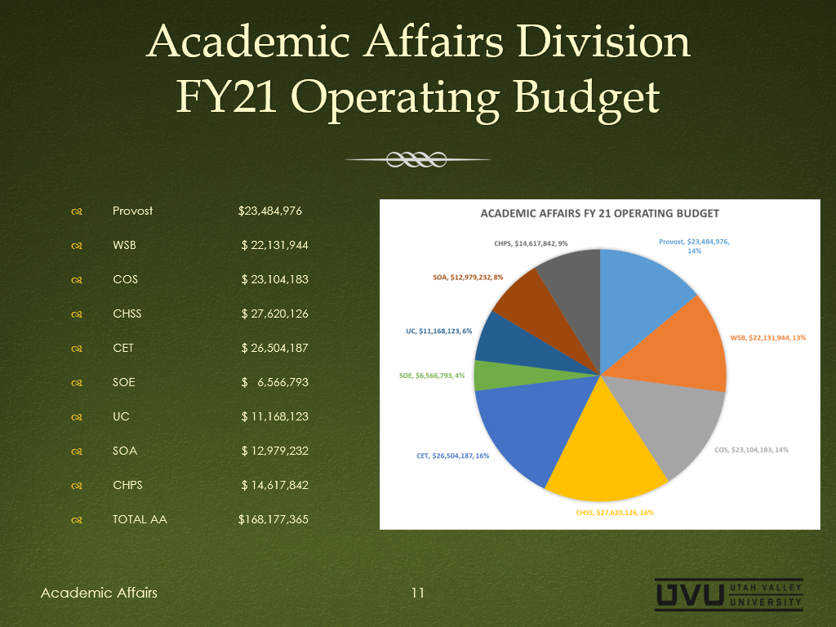

Slide 6
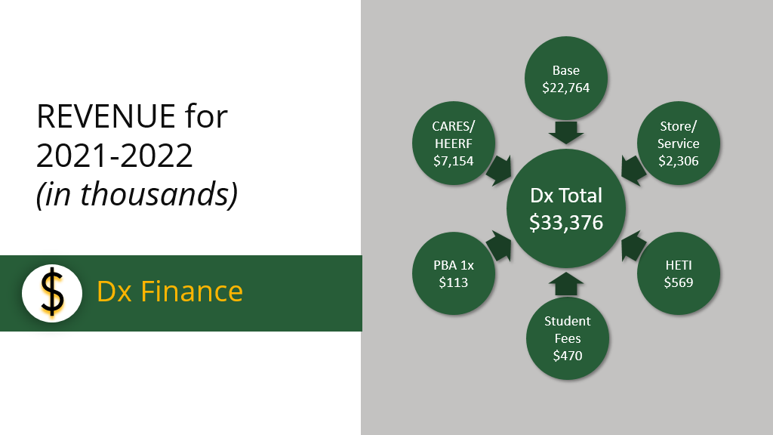

Slide 7
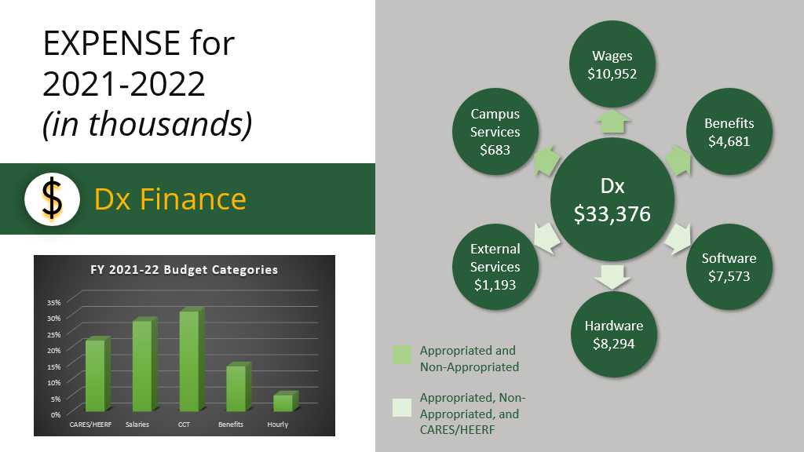

Slide 8
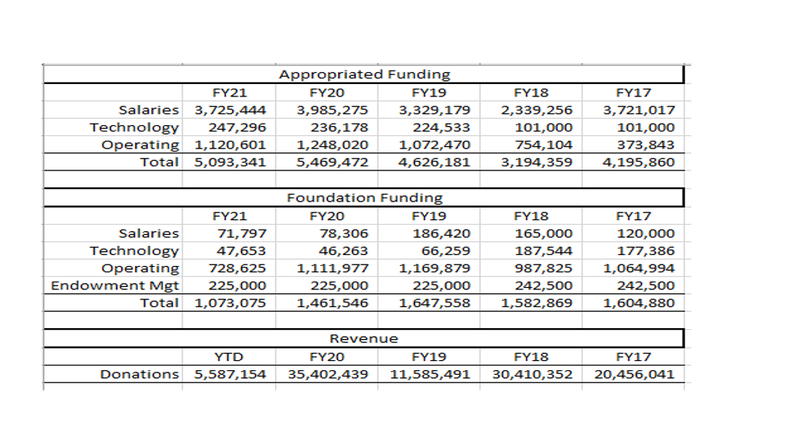

Slide 9
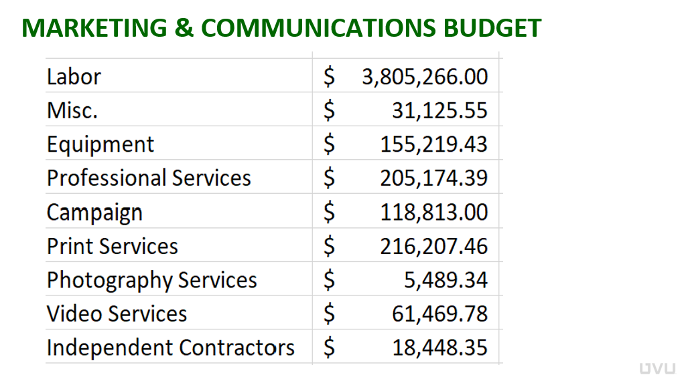

Slide 10
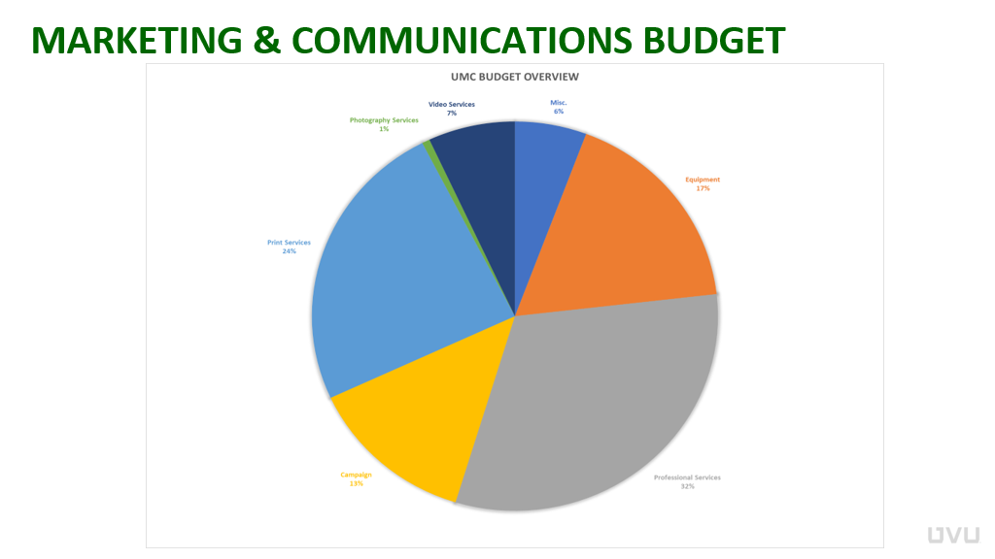

Slide 11
